Slide 1
FMS SOFTWARE
Portable Buffer Download
© TSI Incorporated
3/6/2019
1

Slide 2
FMS software
Portable Buffer Download
Why would an user need Portable Buffer Download?
Routine monitoring using portable particle counters means lots of paper being generated
Recording of data (paper or downloaded) collected from portable particle counters occupies skilled staff
Grade C and D areas needs to be monitored based on a risk assessment
© TSI Incorporated
3/6/2019

Slide 3
FMS software
Portable Buffer Download
Benefits
No paper trail
No time spent downloading and interpreting data
Enables Grade C and D areas to be routinely monitored
Particle counter can also be used independently for other classification and diagnostic activities
© TSI Incorporated
3/6/2019

Slide 4
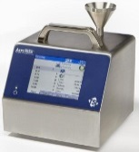

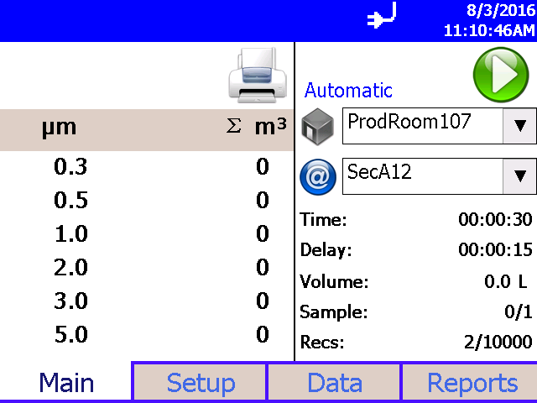
FMS software
Portable Buffer Download
Barcodes:
Easy to generate
Reduce the chance of Human error
Human readable
Zone
Location
AeroTrak portables supports 1D USB Barcode Scanners!
© TSI Incorporated
3/6/2019
4

Slide 5
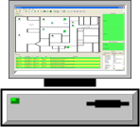
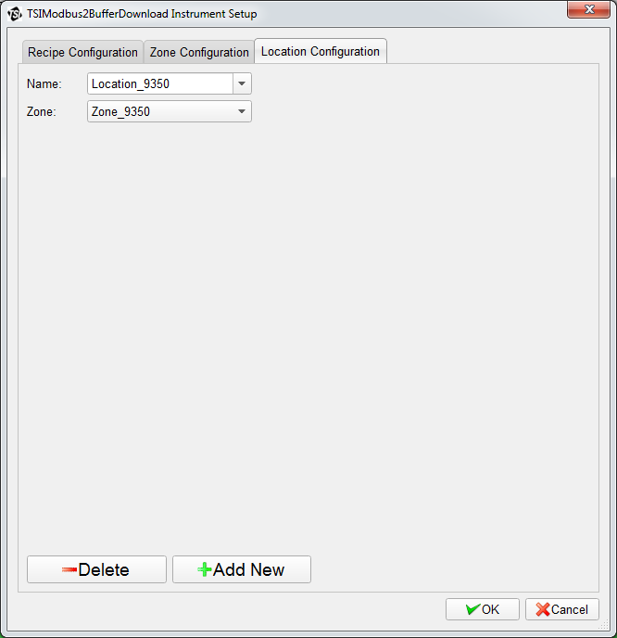
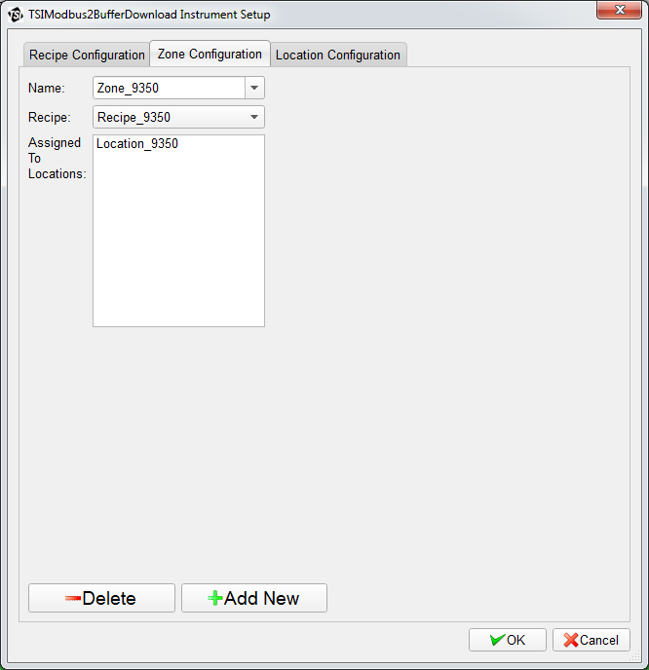
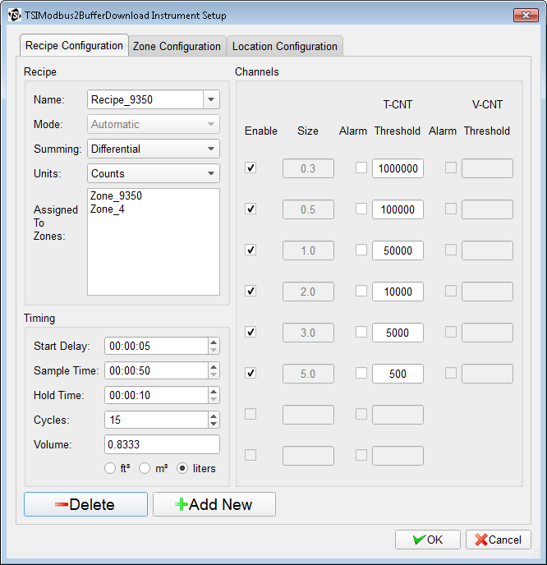
FMS software
Portable Buffer Download
FMS 5.3.0
Locations
Zones
Recipes
© TSI Incorporated Confidential
3/6/2019
5

Slide 6
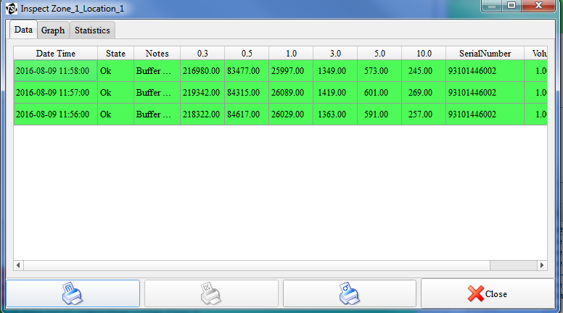
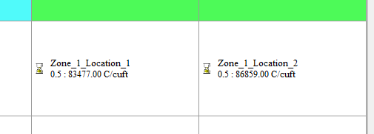
FMS software
Portable Buffer Download
Data tagged as buffered
Note: Serial number of unit is tracked
Status Screen View
Traceability
© TSI Incorporated
3/6/2019
6

Slide 7
Question ?
© TSI Incorporated Confidential
3/6/2019
7

