Slide 1
FMS Hardware: APC Instruments
AEROTRAK+ Remote
AEROTRAK+ Remote with Pump
AEROTRAK Remote (existing)
AEROTRAK Remote with Pump (existing)
AEROTRAK Portables

Slide 2

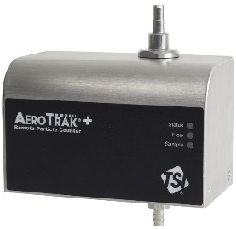
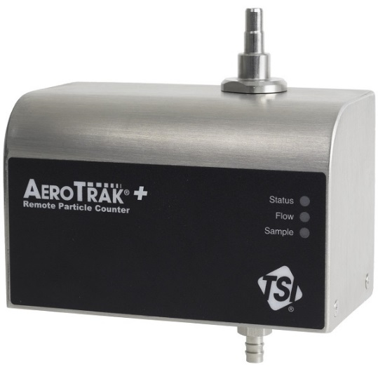
All New!
Prevent accidental ingress of cleaning liquids from above.
Reduces particle traps in the flow path that can lead to spurious counts
Improve reliability, reduces false counts due to electrical interference.
New sealed inlet design
Inlet supports direct mount ISP
No sharp edges that might tear cleanroom attire
Meets heavy industrial radiation emissions immunity standards
Curved case, smooth edges
No special cables needed. Convenient and easy way to setup the instrument.
304 Stainless Steel enclosure
Easy for end users to see status locally, even when the counter is installed in an enclosure.
USB-C connector
Larger, ultra bright status, flow and sampling indicator LEDs.
Power over Ethernet 100 Mbit/s, supports 2 concurrent TCP/IP connections (Sockets)
9 -24 Volts DC power
Robust power connector
Backwards compatible offering customers flexible power options
Now customers can connect another device such as a chart recorder. Means we can do some cool stuff too, more on this later!
Notes:
Why should the customer care
PMS Airnet II is not sealed inlet

Slide 3

A bit deeper…(10mm)
we integrated the 2 ch 4-20mA analog output option. All 7000 series remotes are the same size.
A bit taller…(1.5mm)
we added live flow monitoring
Analog output remote models faster to setup. Ethernet and USB-C connector is accessible.
Uses up less wall space than current models.
Now all units will monitor volumetric flow rate at the inlet of the unit.
Notes:
Why should the customer care

Slide 4

No disruption it’s a direct swap out
Fits onto current wall bracket
New wall bracket more robust and has same spacing for mounting holes
No new cabling is needed
No need to drill new holes if you want to use the new bracket
4-20mA analog output option connector pin-out is the same
No need to update power, unit will work with already installed 12v DC power.
Unit is compatible with most commonly used 24 v DC power
Current Modbus Map is supported
9 -24 v DC power
Works with FMS versions 5.1.0 and newer.
Works with third party drivers that have used current Modbus map
Notes:
Why should the customer care

Slide 5
More processing power
Almost 6 months on board data storage at 1 minute sample interval
180 x > PMS Airnet II
80 x > Lighthouse APEX R5
25 x > Climet Trident
Peace of mind. Data is safe.
Correct time associated with particle count data is critical when correlating data with other systems in the facility
Delay can result in wasted product
Instrument status and flow error LEDs updated within 1 second of an error condition occurring
Network Time Protocol NTP supported
Sample light flashing linked to particle counting activity
Relay output can be mapped to FMS or internal hardware alarms, which are updated within 1 second
Missing from current models. Great for troubleshooting, zero counting or notifying operators of particle count events
Delay can result in wasted product
Notes:
Why should the customer care

Slide 6
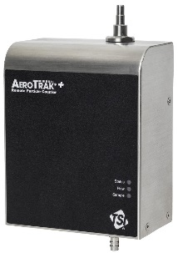
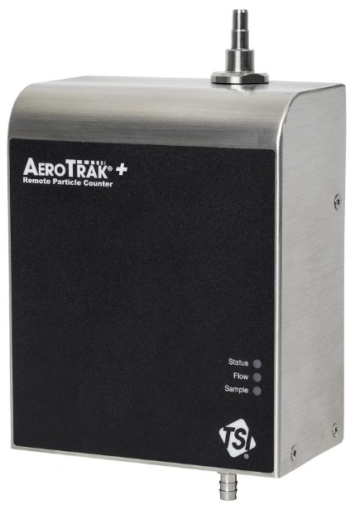
No particle traps, perfect for room monitoring
New inlet design allows for direct mount ISP and direct tubing connections
Volumetric flow control
New robust wall bracket. Mounting hole spacing is identical to first generation bracket
ISO 21501-4 calibration is maintained
Almost 6 months on board data storage at 1 minute sample interval
No need to drill new holes for new bracket
180 x > PMS Airnet II
80 x > Lighthouse APEX R5
25 x > Climet Trident
Unit does not contaminate the process.
Unit powered
via POE
HEPA filter Exhaust
Easy to install Only one cable needed to run the unit
Notes:
Why should the customer care

Slide 7
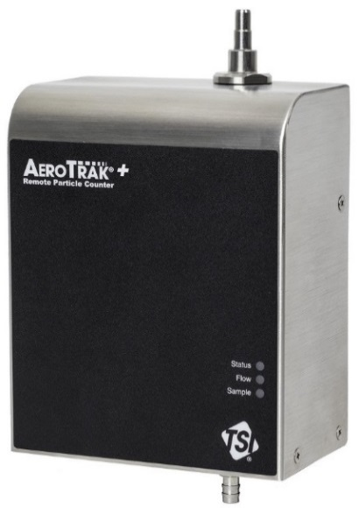
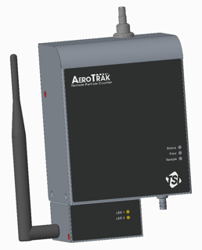
4-20mA analog output option
9 -24 v DC
LoRa Wireless Node Accessory
No new wiring needed pin out is the same
100m range reduces installation complexity
Long Range Wireless
Reduces Installation Complexity
Notes:
Why should the customer care

Slide 8
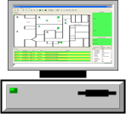
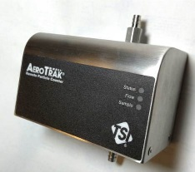
Rapid Configuration
AeroTrak⁺ Configuration in FMS 5.5
Auto Discovering
Who is present ?
FMS will populate the available instrument to be configured

Slide 9
Rapid Configuration
AeroTrak⁺ Configuration in FMS 5.5
Push / Pull Configuration
FMS pulled
configuration
FMS will push configuration to all available and unconfigured AeroTrak⁺
FMS retrieves AeroTrak⁺ configuration and save it as a template

Slide 10

Rapid Configuration
AeroTrak⁺ Configuration in FMS 5.5
Network Time Protocol
FMS pulled
configuration
Sync FMS System with Other Systems
Time Server

Slide 11
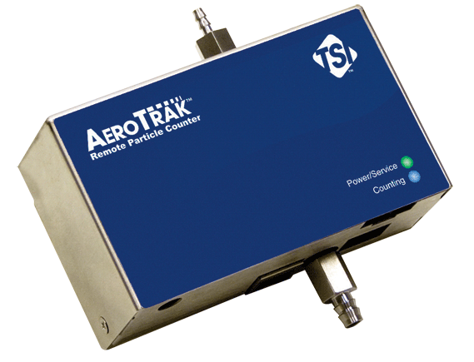
AeroTrak Remote
Monitoring Grade A & B
AeroTrak 7510-01F
VHP Resistant Model available
ISO 21501-4 compliant
Power over Ethernet communications TCP/IP
Integrated flow monitoring
Built in web browser
Small footprint
3,000 record internal buffer/memory
0.5 and 5µm
@ 1 cfm
Regulated flow
(1.0cfm)
Critical
orifice
vacuum pressure
© TSI Incorporated
3/6/2019
11

Slide 12
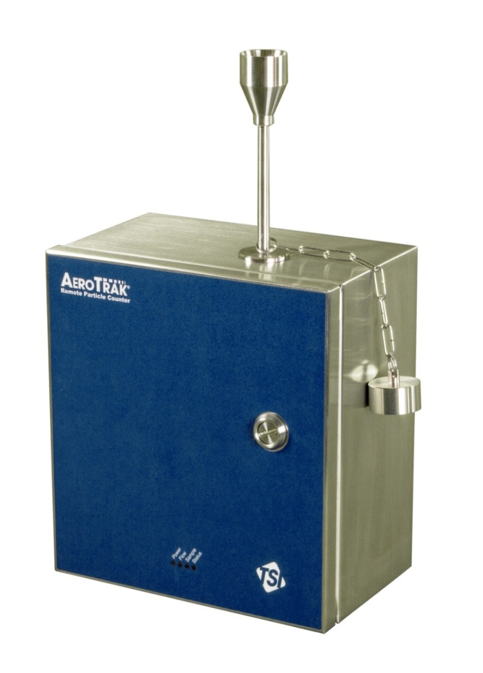
AeroTrak Remote with Pump
Monitoring Grade A & B
AeroTrak 6510
Integrated Pump
VHP Resistant Model Available
4 x 4-20mA Analog Inputs
4-20mA analog output
Auto flow block detect
Hot swappable optics and pump assembly
ISO 21501-4 compliant
Ethernet communications (TCP/IP)
Built in web browser
3,000 record internal buffer/memory
12
© TSI Incorporated
3/6/2019

Slide 13
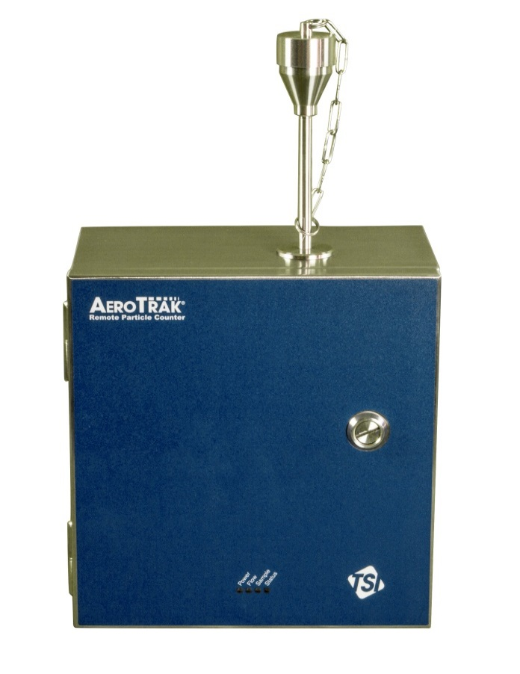
AeroTrak Remote
Monitoring Grade A & B
Vaporized
Hydrogen Peroxide
316L Stainless Steel -Passivated
Inlet capping/blockage auto detect
Model 6510-VHP is VHP resistant
Dual HEPA
Filtered
13
© TSI Incorporated
3/6/2019
Notes:
Cleaning
Particle counters are sensitive optical instruments and damage will result if any liquids enter via the instrument sample inlet, even when powered down. During cleaning, the inlet of the instrument requires capping or isolating. To facilitate this when centralized vacuum systems are used, end users have to power down the central vacuum system. If the end user wants to cap the sensor inlet whilst the centralized vacuum pump is running, it is necessary to install vacuum relief valves in the vacuum line to prevent damage to the pumps and the particle counter.
In the case of a remote particle counter with an integrated pump, the flow rate is controlled internally. If these units are capped when their vacuum blower is running, it may appear as though there is an inlet restriction, like a very long length of sample tubing has been attached to the inlet. Based on this, the unit could then attempt to pull 1 CFM when this is physically impossible as the inlet is blocked, resulting in instrument damage.
To solve this problem, the AeroTrak Remote with Pump has integrated Flow Block detection functionality. This means the unit will automatically stop the blower when it detects that the flow is restricted or blocked. The time taken for the blower to switch off (Error Time Out) is user configurable, as well as how long the unit will wait until it tries to restart the blower (Pump Off Time) This feature prevents accidental damage to the particle counter and makes it easier for the end user to cap off the instrument inlet without first powering it down.
Additionally the 316L passivated stainless steel enclosure provides protection for the unit’s internal components from the powerful oxidizing effects of VHP.

Slide 14
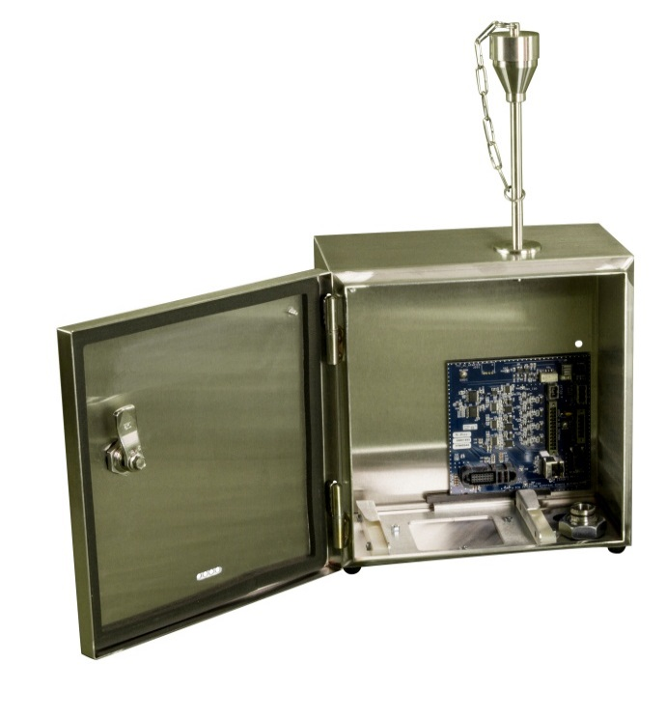



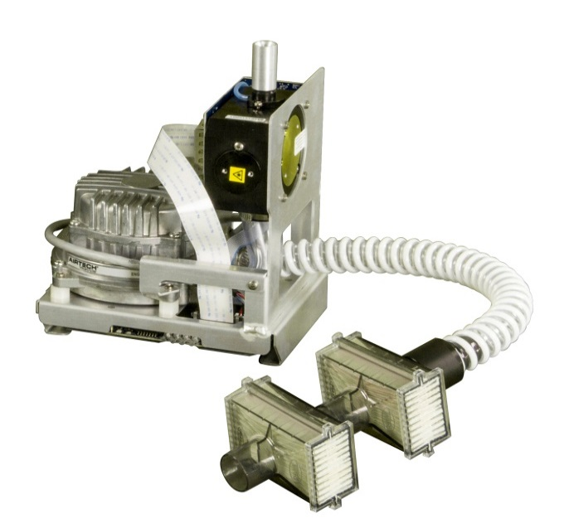

GMP
Hot Swap Spare
Pump/Sensor
Hot swappable sensor and pump assembly
14
© TSI Incorporated
3/6/2019
Notes:
Service and Calibration
With this issue in mind, TSI has designed the unit with a removable sensor assembly that comes with the blower, the main board, the optics block, the laser board and the detector board fully integrated. It can be easily removed as a single assembly without the need to bring tools into the cleanroom.
Not only that, because the assembly is hot swappable, there is no need to power down the unit, reducing the risk of instrument damage.

Slide 15
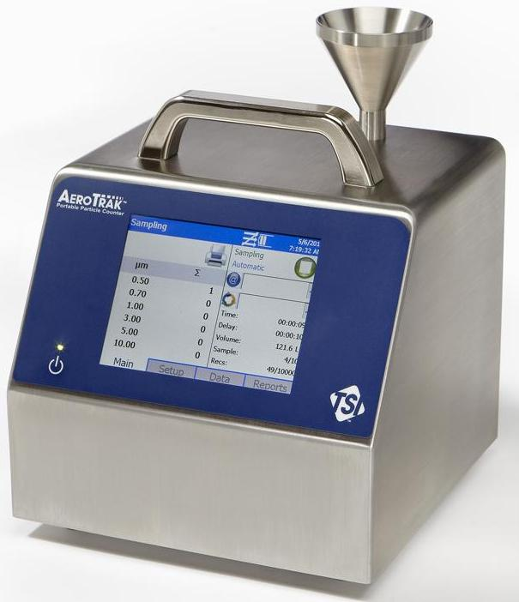
AeroTrak Portable
Monitoring Grade C & D
AeroTrak 9310/9350/9500
Lightest 100 l/min portable on the market
All models have the same foot print
10,000 Data record memory
21 CFR Part 11 data download via USB
Easy to use interface
Most powerful blower design
No pump maintenance required
No cooling fan = no particle contamination source
ISO 21501-4 compliant
ISO 14644-1:2015 and EU GMP reporting
1 CFM
50 l/min
100 l/min
0.3µm-25µm
    Data from sampling campaign can be downloaded to FMS Software
© TSI Incorporated
3/6/2019
Notes:
Grade C & D must also be monitored following a Risk Assessment which will be once a day, a week or once a month.
These Sampling Data can then be Uploaded to the FMS System for further trends, Reports and also for long term archiving which is not the case when using a portable and printing the results!

Slide 16
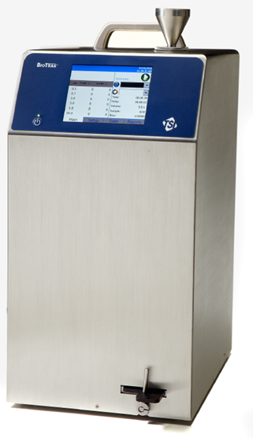
BioTrak 9510-BD
Real-Time
Microbial
Detection
Rapid Microbiological Methods (RMM)
© TSI Incorporated
3/6/2019

Slide 17
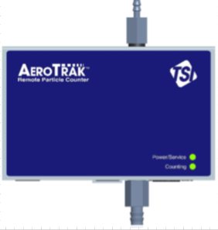
AeroTrak⁺ Remote
Rapid Configuration
Configuration prior to FMS 5.5
Setup Network settings on web page
Create Communication Channel

Slide 18
AeroTrak⁺ Remote
Rapid Configuration
Configuration prior to FMS 5.5
Create Unit
Create Sample Points (FT³ & M³)

Slide 19
Questions ?
© TSI Incorporated
3/6/2019
19

