Slide 1
FMS – Regulations, Standards, and Guidance Documents

Slide 2
Regulations, Standards, and Guidance Documents
We have to do it, it’s required by the regulations!
People often cite “regulations” that aren’t regulatory requirements
Important to understand the differences between regulations, standards, and guidance documents

Slide 3
Regulations, Standards, and Guidance Documents
Categories:
Good Manufacturing Practices (GMPs)
Pharmacopeias
ISO Standards
Guidance Documents
Can be confusing
Some are legally binding some are not
Some may have parts that are required to be followed and parts that are informational
May refer to each other
Not Legally Binding
May or May not be Legally Binding
Legally Binding

Slide 4
GMPs
GMPs are the current Good Manufacturing Practices as specified in the laws, rules, or regulations of an applicable Regulatory Authority at the time of manufacture
Pharmaceutical and Medical Device manufacturers are legally obligated to comply
Notes:
These are the law
These are what the agencies will reference in findings

Slide 5
GMPs
US Code of Federal Regulations Title 21 (21 CFR)
Part 11 Electronic Records; Electronic Signatures
Part 211 Current Good Manufacturing Practice for Finished Pharmaceuticals
Part 820 Quality System Regulation (Med Device)
Notes:
There are hundreds of parts, these are the ones that pertain to EM and monitoring systems.
These are very general requirements and do not describe methods

Slide 6
GMPs
EudraLex – The Rules Governing Medicinal Products in the European Union
Volume 4 – EU Guidelines for Good Manufacturing Practice for Human and Veterinary Use
Commonly referred to as EU GMP
Harmonized with Pharmaceutical Inspection Co-operation Scheme (PIC/S) and WHO
Annex 1 – Manufacture of Sterile Medicinal Products
Annex 11 – Computerised Systems
Notes:
These cover most of the world outside the US, but you should check on the GMPs for any country outside the EU.
Much more detailed and prescriptive than US GMPs
FDA and EU GMPs are similar but not identical. US is now a member of PIC/S so hopefully there will be harmonization in the future.

Slide 7
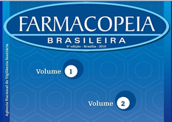
Pharmacopeias
Standardized pharmaceutical test methods and specifications
Each country or region has their own compendium
Each method and/or specification is numbered and is called a monograph
Compliance is required
Most do not have monographs for monitoring
Notes:
JP and USP have monographs for monitoring

Slide 8
Pharmacopeias
JP aligns closely to EU Annex 1
USP
Monographs with monitoring methods
USP <797> Pharmaceutical Compounding – Sterile Preparations
USP <1116> Microbiological Control and Monitoring of Aseptic Processing Environments
Compliance is not required for all USP monographs
USP <1> to <999>, yes
Above <999>, are informational only
Not Legally Binding
Legally Binding

Slide 9
ISO Standards
Published by the International Organization for Standardization
Voluntary international standards that facilitate world trade by providing common standards between nations
Not specific for any industry
Notes:
No longer are voluntary when directed to follow in GMPs

Slide 10
Cleanroom ISO Standards
ISO 14644, Cleanrooms and associated controlled environments (17 Parts)
Parts 1 & 2 referenced in GMPs
ISO 14698, Cleanrooms and associated controlled environments -- Biocontamination control (2 Parts)
Not referenced in GMPs
ISO 21501, Determination of particle size distribution (4 Parts)
Part 4 referenced in ISO 14644-1&2
The body of a standard is Normative (required)
Annexes can be Normative (required) or Informative (optional)
Makes these legally binding for industries that follow the GMPs

Slide 11
FDA Guidance Documents
FDA Guidance for Industry
Represent FDA’s current thinking on a topic
An alternative approach can be used if the approach satisfies the requirements of the applicable statutes and regulations
FDA Guidance for Industry – Sterile Drug Products Produced by Aseptic Processing – Current Good Manufacturing Practice
Stated it should be viewed only as recommendations – however, generally viewed as an extension of the GMPs
Notes:
Provides more detailed and prescriptive guidance, similar to EU GMPs

Slide 12
Other Guidance Documents
Prepared by professional organizations
Provide detailed descriptions or examples of how to meet GMP or compendial requirements
Can be very useful, but are not regulations
Examples:
PDA Technical Report (TR) 13
PHSS Technical Monographs 16 & 20
IEST Recommended Practices (RPs)
ISPE Baseline Guides
ISPE Good Automated Manufacturing Practice (GAMP) Guides

Slide 13
Why Monitor?
Life Sciences (Pharma & Med Device)
It’s the law! - Follow GMPs
Protect patients
Increase yield/reduce waste
Compounding Pharmacies
It’s the law! – USP<797>
Protect patients
Non-regulated Industries
Voluntarily follow ISO Standards
Increase yield/reduce waste
Notes:
Companies only doing it to meet regulations often miss out on a lot of the value that monitoring can offer.

Slide 14
Why Monitor?
21 CFR
21 CFR 211.42(c)(10) Aseptic processing, which includes as appropriate: * * * (iv) A system for monitoring environmental conditions; * * *.”
21 CFR 820.70(c)***Environmental control system(s) shall be periodically inspected to verify that the system, including necessary equipment, is adequate and functioning properly. These activities shall be documented and reviewed.

Slide 15
Why Monitor?
EU GMP Annex 1
9.27 Where monitoring is routinely performed by manufacturing personnel, this should be subject to regular oversight by the quality unit (refer also to paragraph 8.19).
8.19 Aseptic operations (including APS) should be observed on a regular basis by personnel with specific expertise in aseptic processing to verify the correct performance of operations including operator behaviour in the cleanroom and address inappropriate practices if detected.
Notes:
9.27 is in regards to Environmental and personnel monitoring of viable particles.

Slide 16
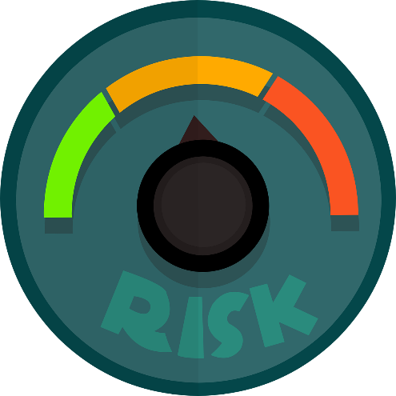
Why have a Continuous Monitoring System?
Patient Risk
Required in the GMPs for sterile manufacturing
Business Risk
Reduce costs and product waste
Must be able to show return on investment to justify
Notes:
GMPs provide a minimum requirement so even when it is not required to have a monitoring system it may make sense for risk reduction and is acceptable for use.

Slide 17
Why have a Continuous Monitoring System?
FDA Aseptic Guidance
We recommend that measurements to confirm air cleanliness in critical areas be taken at sites where there is most potential risk to the exposed sterilized product, containers, and closures. The particle counting probe should be placed in an orientation demonstrated to obtain a meaningful sample. Regular monitoring should be performed during each production shift. We recommend conducting nonviable particle monitoring with a remote counting system. These systems are capable of collecting more comprehensive data and are generally less invasive than portable particle counters.

Slide 18
Why have a Continuous Monitoring System?
EU GMP Annex 1
9. For Grade A zones, particle monitoring should be undertaken for the full duration of critical processing, including equipment assembly, except where justified by contaminants in the process that would damage the particle counter or present a hazard, e.g. live organisms and radiological hazards. In such cases monitoring during routine equipment set up operations should be undertaken prior to exposure to the risk. Monitoring during simulated operations should also be performed. The Grade A zone should be monitored at such a frequency and with suitable sample size that all interventions, transient events and any system deterioration would be captured and alarms triggered if alert limits are exceeded.

Slide 19
Why have a Continuous Monitoring System?
EU GMP Annex 1
9.16 For grade A, particle monitoring should be undertaken for the full duration of critical processing, including equipment assembly.
9.17 The grade A area should be monitored continuously (for particles ≥0.5 and ≥5 µm) and with a suitable sample flow rate (at least 28 litres (1ft3 ) per minute) so that all interventions, transient events and any system deterioration is captured. The system should frequently correlate each individual sample result with alert levels and action limits at such a frequency that any potential excursion can be identified and responded to in a timely manner. Alarms should be triggered if alert levels are exceeded. Procedures should define the actions to be taken in response to alarms including the consideration of additional microbial monitoring.

Slide 20
Electronic Records
21 CFR Part 11
EU GMP Annex 11
Requirements to assure records generated by computerized systems are trustworthy and reliable
Claiming software as being Part 11 or Annex 11 compliant in not accurate, software can only be said to be designed to meet the requirements

Slide 21
Summary
Regulations
US
21 CFR Parts 11, 211, 820
FDA Aseptic Guide (nominally no, in reality yes)
USP <797>
EU & most of the rest of world
EU (PIC/S, WHO) GMP Annexes 1, 11
Many documents exist that offer valuable guidance for meeting the regulations

