Slide 1
What is a Monitoring System?
© TSI Incorporated

Slide 2
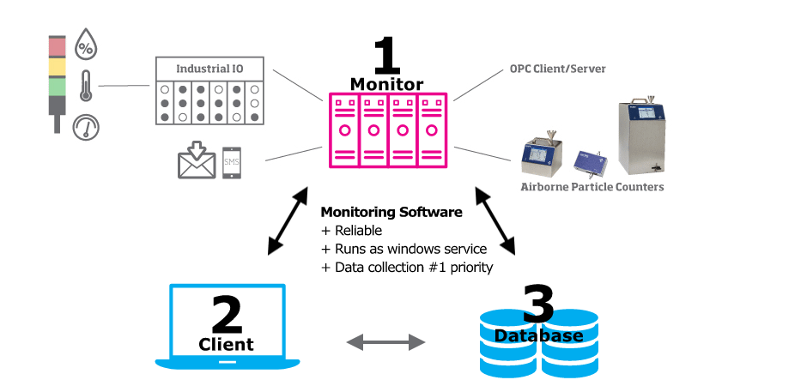
What is a Monitoring System?

Slide 3
What is a Monitoring System?

Slide 4
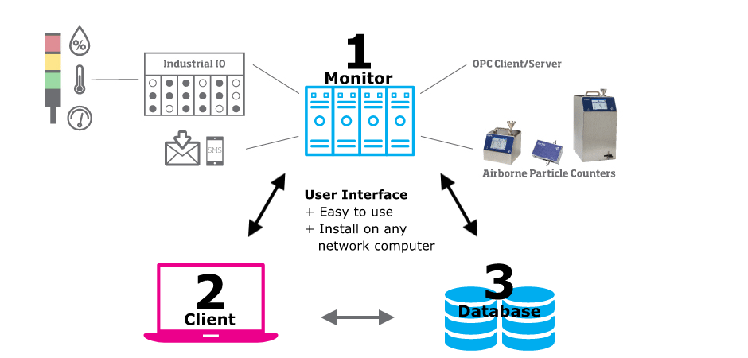
What is a Monitoring System?

Slide 5
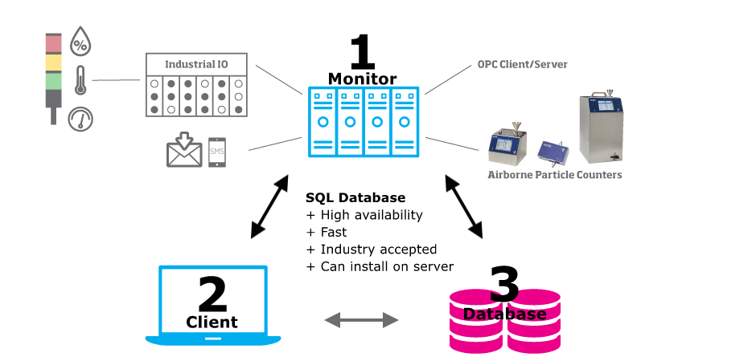
What is a Monitoring System?

Slide 6
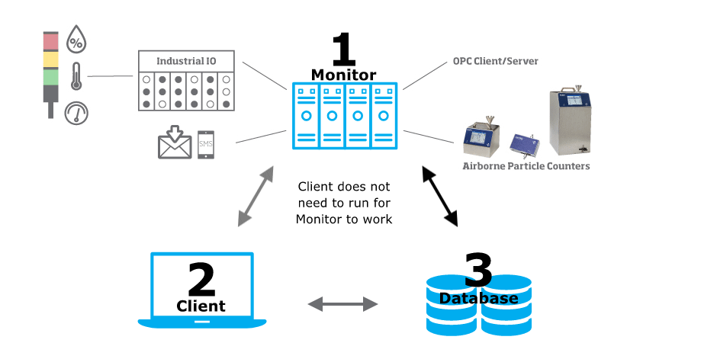
What is a Monitoring System?

Slide 7
What is a Monitoring System?

Slide 8
What is a Monitoring System?
Database access from multiple clients
21 CFR 11 Capable

Slide 9
What is a Monitoring System?

Slide 10
Why Continuously Monitor?
ISO 8
ISO 7

Slide 11
Why Continuously Monitor?
ISO 9
ISO 7

