Slide 1
FMS – Validation

Slide 2
GMP Requirements for Validation of Systems
It is a regulatory requirement to validate computerized systems
It provides documented evidence the system is suitable for its intended use

Slide 3
GMP Requirements for Validation of Systems
21 CFR Part 11
11.10 Controls for closed systems
… controls shall include the following:
Validation of systems to ensure accuracy, reliability, consistent intended performance, and the ability to discern invalid or altered records.
21 CFR Part 820
820.70 Production and process controls.
(i) Automated processes. When computers or automated data processing systems are used as part of production or the quality system, the manufacturer shall validate computer software for its intended use according to an established protocol.
Notes:
These are just a couple of the references in the US GMPs .

Slide 4
GMP Requirements for Validation of Systems
EU GMP Annex 15
Principle
…It is a GMP requirement that manufacturers control the critical aspects of their particular operations through qualification and validation over the life cycle of the product and process… …Computerised systems used for the manufacture of medicinal products should also be validated according to the requirements of Annex 11…
Notes:
Just one of the references in the EU GMPs .

Slide 5
What is GAMP 5?
GAMP - Good Automated Manufacturing Practice
Series of Good Practice Guides published by the ISPE (International Society for Pharmaceutical Engineering)
GAMP 5: A Risk-Based Approach to Compliant GxP Computerized Systems
Well respected guidance for achieving compliant computerized systems
Includes guidance over the entire life cycle, including validation

Slide 6
What is GAMP 5?
A cost effective framework of good practices to ensure that computerized systems are fit for intended use and compliant with applicable regulations
It recognizes that most computerized systems are now based on configurable packages, many of them networked
It recognizes that there are acceptable methods other than those described in the Guide

Slide 7
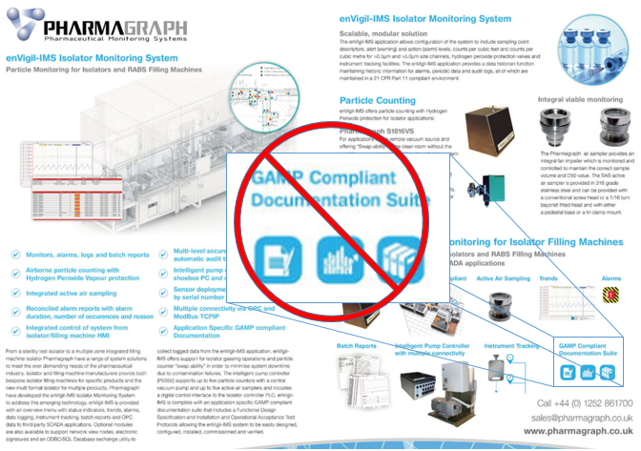
What is GAMP 5?
“GAMP documents are guides and not standards. It is the responsibility of regulated companies to establish policies and procedures to meet applicable regulatory requirements. Consequently, it is inappropriate for suppliers or products to claim that they are GAMP certified, approved, or compliant.”
Better to state that documents follow GAMP principles or similar
Notes:
First bullet is direct quote from the guide

Slide 8
Life Cycle Approach
Validation Related Activities

Slide 9
V-Model for a Configured Product
Notes:
Validation model
Guide also covers approaches for Non-Configured Products and Custom Applications

Slide 10
Supplier Involvement
Encourages companies to leverage suppliers
“Regulated companies should seek to maximize supplier involvement throughout the system life cycle in order to leverage knowledge, experience, and documentation, subject to satisfactory supplier assessment.”
Supplier activities typically include:
Supply of the product
Production of specifications and test specifications on behalf of the regulated company
Support during configuration and testing
User documentation
Training
Support and maintenance activities

Slide 11
User Requirement Specification (URS)
The URS is the responsibility of the regulated company, but may be written by a third party or supplier.
The URS should define clearly and precisely what the regulated company wants the system to do, state any constraints, and define regulatory and documentation requirements.

Slide 12
User Requirement Specification (URS)
A good URS is the key to a successful project.
Users don’t often have the knowledge or expertise to do well; they want assistance
Chance to educate on system capabilities that can lead to “lockout” specs
Specifications need to be written such that they state what is needed, not how it is to be done

Slide 13
System Specifications
There are a number of types of specifications that may be required to adequately define a system. These may include Functional Specifications, Configuration Specifications, and Design Specifications
Functional Specifications are normally written by the supplier and describe the detailed functions of the system
Configuration Specifications are used to define the required configuration of one or more software packages that comprise the system.
Design Specifications used for custom systems.

Slide 14
Verification Testing
Testing that demonstrates fitness for intended use and allow acceptance of the system against requirements
Testing typically covers:
Correct installation
Configuration of the system
Functionality that supports the specific business process based on risk and supplier assessments
Notes:
IQ OQ

Slide 15
Verification Testing
The specific terminology used to describe life cycle activities and deliverables varies from company to company and from system type to system type.
Qualification terminology is generally used.
The use of qualification terminology in relation to computerized systems and the relationship between OQ and PQ in particular, varies from company to company.

Slide 16
Qualification Terminology
DQ is generally only used for custom applications
PQ is not applicable for monitoring systems since they do not produce anything that has to meet a requirement

Slide 17
TSI Documents
TSI has Validation Documents for FMS based on GAMP 5 recommendations
User Requirement Specification – P/N 6004420
Functional Design Specification – P/N 6004220
Configuration Statement – P/N 6004422
Installation Qualification Protocol – P/N 6004221
Operational Qualification – P/N 6004222

Slide 18
Summary
Computerized systems such as FMS are required to be validated by the GMPs
The ISPE GAMP 5 Guide provide widely recognized and accepted guidance on how to meet these requirements
TSI validation documents were created per the GAMP 5 guidance

