Slide 1
FMS Software
SOFTWARE ARCHITECTURE
© TSI Incorporated Confidential
3/7/2019
1

Slide 2
Supported OS
Windows 10 (32 & 64 bit)
Professional or above
Windows 7 (32 & 64 bit)
Professional or above
Windows Server 2012 R2
Windows Server 2016 R2

Slide 3
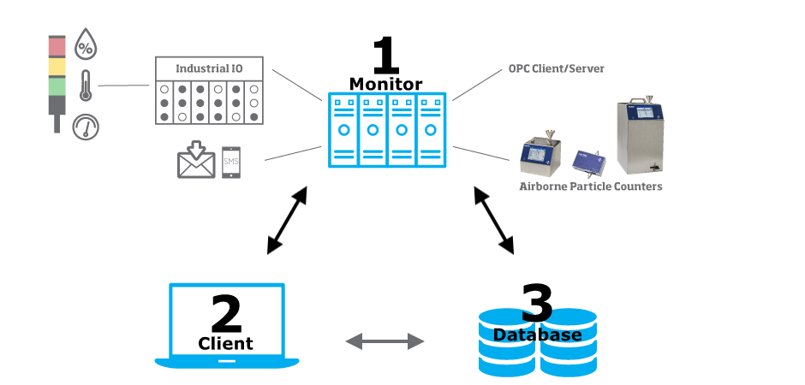
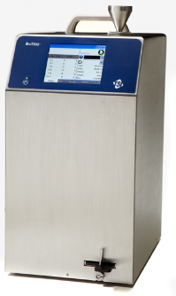
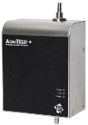
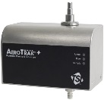
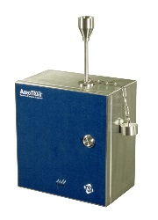
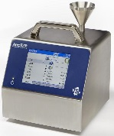
What is FMS Core?

Slide 4
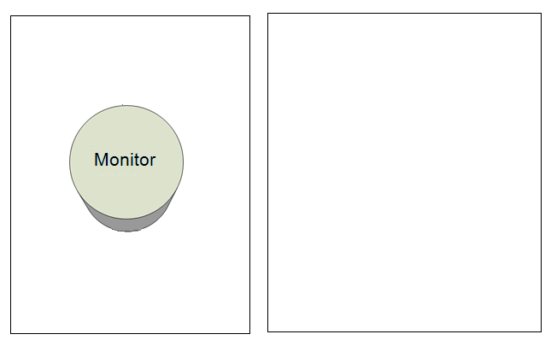
FMS software: Supported Databases
Supported Databases
PostgreSQL *
ODBC
Microsoft SQL Server
© TSI Incorporated Confidential
3/7/2019

Slide 5
Supported Database
PostgreSQL Server (by Default)
Contact TSI Inc. prior using the Databases listed below :
Microsoft SQL Server 2012
Microsoft SQL Server 2014
Microsoft SQL Server 2016 x64
Note:
TCC-168_Authorized_Components_TSI_FMS_Software_RevD
TCC-169_Computer_Requirements_TSI_FMS_Software_RevD

Slide 6
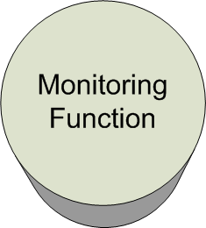
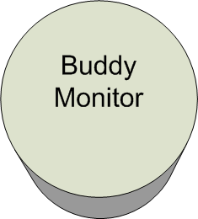
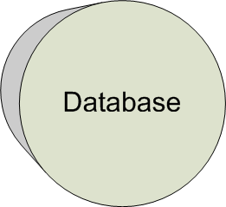
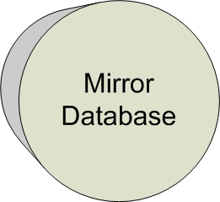
FMS software: Distributed design
Monitoring hardware (not shown) is connected to dedicated LAN
Distributed design allows for
components of the monitoring
system to be installed on separate
computers
Hot automatic standby monitor
Automatic hot standby
and database mirroring delivers a robust monitoring system
Clients do not need to be running for the monitoring system to work
© TSI Incorporated Confidential
3/7/2019
6

Slide 7
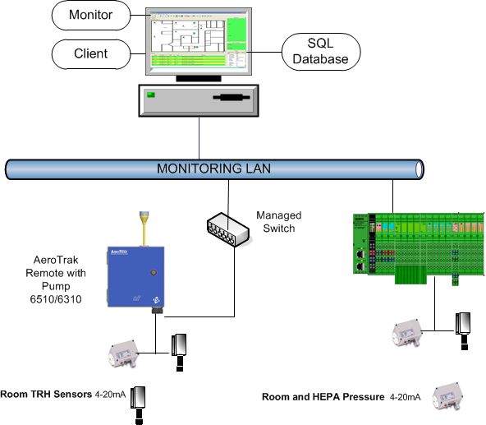
FMS Topology

Slide 8
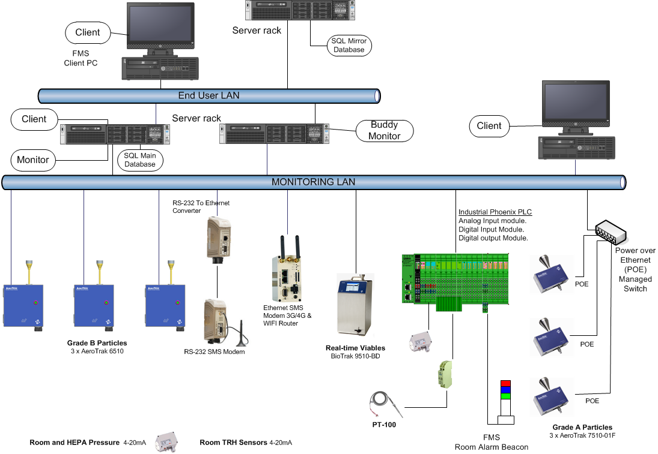
© TSI Incorporated Confidential
3/7/2019
8
Notes:
Look at what we can connect to FMS today!
Look at how we can distribute the system design today!

Slide 9
FMS Software
Reliable
Redundancy – failover (Buddy)
Redundancy – mirror database
Secure, high availability databases
Easy to use
© TSI Incorporated Confidential
3/7/2019
9

Slide 10
Question ?
© TSI Incorporated Confidential
3/7/2019
10

