Slide 1
Sample Probe Location

Slide 2
Agenda
Introduction
Grade A sample probe positioning
  Design considerations
Grade B sample probe positioning
  Design considerations
Grade C and D particle monitoring
© TSI Incorporated
6/7/2019

Slide 3
Introduction
RECAP
Grade A zones should be monitored continuously using Remote, Point of Use or Dedicated particle counters
Grade B zones (when surrounding environment for Grade A) should be monitored continuously using Remote, Point of Use or Dedicated particle counters
Other Grade B and Grade C zones should be monitored to demonstrate that they are in control, portable particle counters, remote particle counters may be used
Consideration should be given to monitoring certain Grade C and D areas where there is a risk that these areas can potentially contribute a significant bioburden
© TSI Incorporated
6/7/2019

Slide 4
Grade A - Particle probe positioning
Identify critical areas based on a formal risk analysis study
Use particle cleanliness classification data to support your monitoring position selection
Use monitoring or qualification data from portable counters to support final monitoring position selection
Look at work flow activities to make sure it is possible to locate probe at this position
Combine this with smoke studies to support initial sample probe positions selection within these areas and the impact of the probe on airflow patterns
Challenge the position by using smoke (contamination) and make sure the particle counter detects the excursion.
Document you rational and support with photographs
© TSI Incorporated
6/7/2019

Slide 5
Grade A – Identify Critical Locations
Risk Based approach to identifying Critical monitoring Locations – Note: these are not the final probe positions, in any case at this stage the facility may not yet be built!
Understand your process, regulator will not be prescriptive, they will say that you understand your process and are best qualified to make these decisions
YOU will have to justify and document critical monitoring locations using sound scientific evidence to the regulator, saying “XYZ” person or company stated it was a good place to monitor is not enough!
What does EU GMP Annex 1 and FDA cGMP say?
© TSI Incorporated
6/7/2019

Slide 6

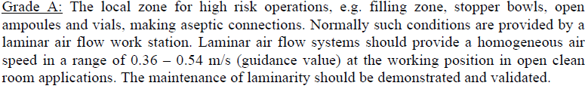
Grade A – EU GMP Annex 1
Section 3 and 8
more helpful…
© TSI Incorporated
6/7/2019

Slide 7

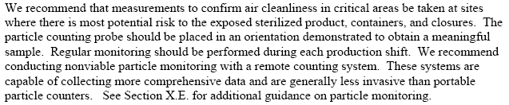
Grade A- FDA Aseptic Processing Guidance 2004
© TSI Incorporated
6/7/2019

Slide 8
Grade A Sample location risk analysis
People are the greatest source of contamination
  Recommended reading “Risk Management of Contamination During Manufacturing Operations in Cleanrooms” PHSS Technical Monograph 14 ISBN 1-905271-12-3
Note: There are many different risk analysis tools available, the same fundamental principles still apply should be based on the principle of Quality Risk Management QRM ICH Q9
© TSI Incorporated
6/7/2019

Slide 9

Grade A Sample location risk analysis
Descrambler table
Vial
Sterilising
Tunnel
Filling
Zone
Stoppering
Zone
Capping
station
Where are the critical locations ?
Where are the locations where there is exposed product, containers or closures?
Where will there be operator interventions and therefore increased risk of contamination to exposed product, containers or closures?
© TSI Incorporated
6/7/2019

Slide 10

Grade A Sample location risk analysis
Descrambler table
Vial
Sterilising
Tunnel
Filling
Zone
Stoppering
Zone
Capping
station
Locations where there is operator intervention and exposed product/container/closures during a filling process present an increased risk of product contamination
= Operator intervention
© TSI Incorporated
6/7/2019

Slide 11
Grade A probe positions
A filling process typically is monitored at these 4 x Grade A critical locations
Vial
Sterilizing
Tunnel
1
4
2
3
Key
Probe location
Operator intervention
1
© TSI Incorporated
6/7/2019

Slide 12
Grade A – Probe Position
Unidirectional air bathing the exposed product during manufacturing
Isokinetic sample probe for particle monitoring (not positioned directly over exposed product)
Exposed product or vials/ampoules
Less than
305 mm
© TSI Incorporated
6/7/2019

Slide 13
Grade A Design Considerations
Sample probes should be located above the work site or critical area, demonstrating the air over the product is clean
ISP not normally more than 305mm from the exposed product or critical area
Isokinetic probe (ISP)oriented in direction of uni-directional airflow
UDAF 0.45m/s (nominal)
ISP inlet diameter designed to match UDAF air velocity of 0.45m/s
0.45m/s
0.45m/s
Isokinetic Sample Probe (ISP)
28.3 lpm
© TSI Incorporated
6/7/2019

Slide 14
Grade A Design Considerations
Distance from Remote counter to Isokinetic sample probe not more than 3 meters. Ideally sample tubing must be kept as short as possible
Sample tubing bends kept to a minimum (ideally no bends)
Bend Radii no less than 15cm
Particle sample tubing typically 3/8” Outside Diameter, ¼” Inside Diameter Bev-a-line tubing or stainless steel.
© TSI Incorporated
6/7/2019

Slide 15
Grade A Probe Position Qualification
How do you determine the final probe location?
Use portable particle counter classification data
Use portable particle counters at the proposed sample locations when performing validation or qualification activities this will determine a probe location that is meaningful, at the same time this will ensure that the proposed location does not interfere with the work flow
© TSI Incorporated
6/7/2019

Slide 16
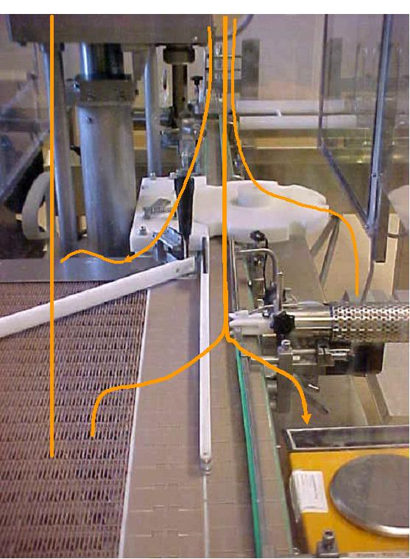
Grade A Probe Position Qualification
How do you determine the final probe location? (continued)
Perform smoke visualisation studies to demonstrate that the proposed probe position does not disrupt the unidirectional airflow around the exposed product or containers
You can challenge the location by generating smoke to ensure the particle counter detects the excursion
© TSI Incorporated
6/7/2019

Slide 17
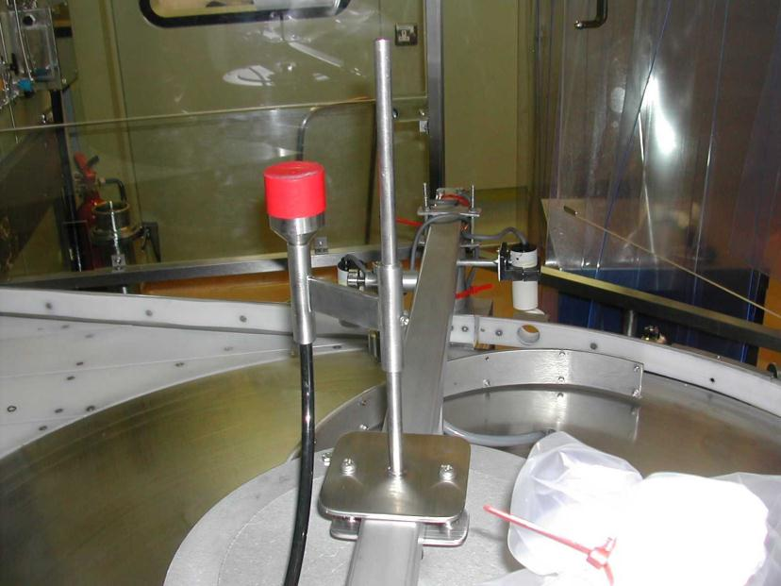
Grade A Probe Position Qualification
Probe shown with Cap in place
Adjustable mount allows vertical and horizontal fine tuning of sampling position.
© TSI Incorporated
6/7/2019

Slide 18
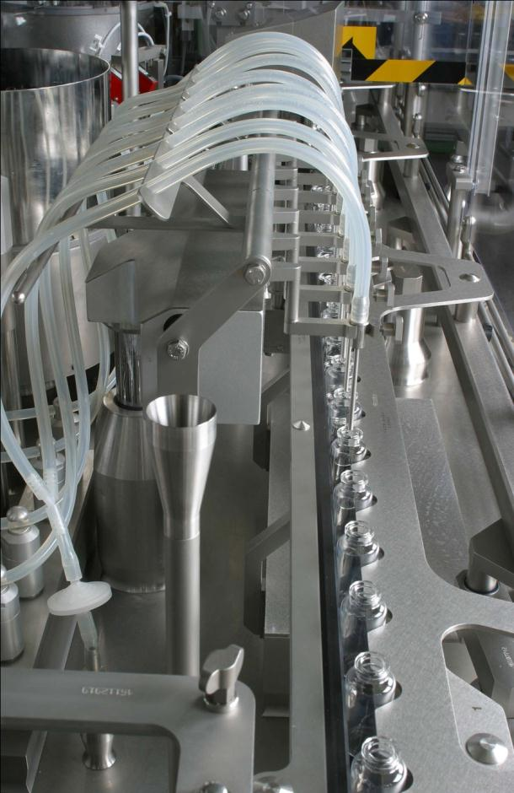
Grade A
Probe Position
Your documentation should include photographs of final probe positions
Probe should not interfere with the workflow
<305mm
© TSI Incorporated
6/7/2019

Slide 19
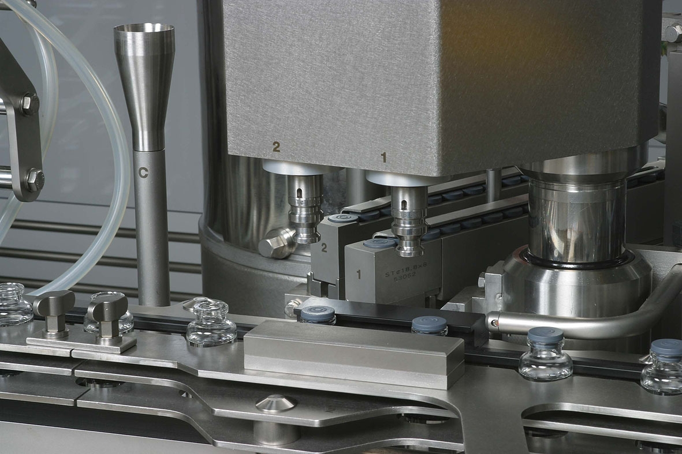
Grade A stoppering station
<305mm
© TSI Incorporated
6/7/2019

Slide 20
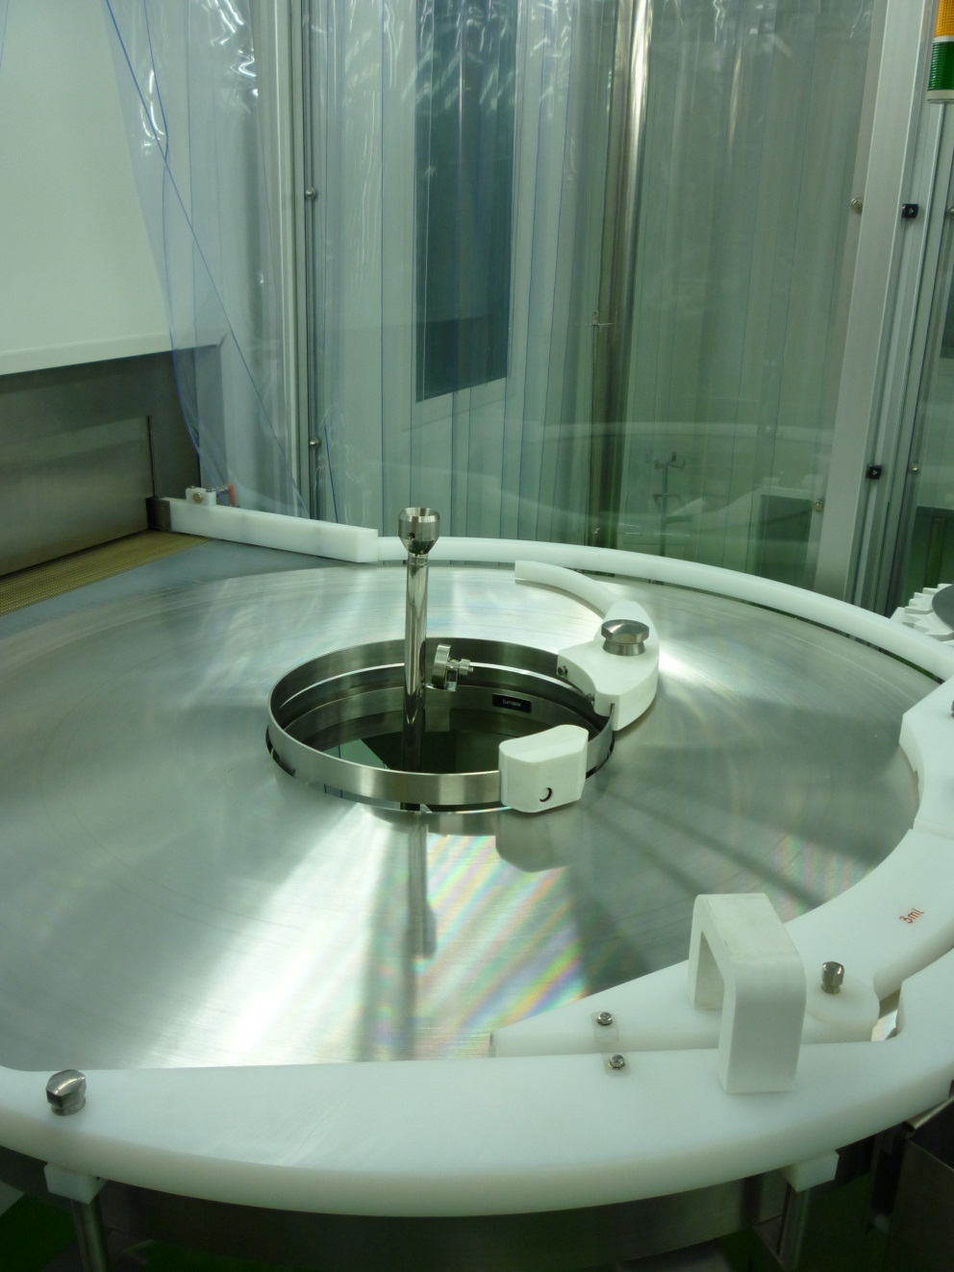
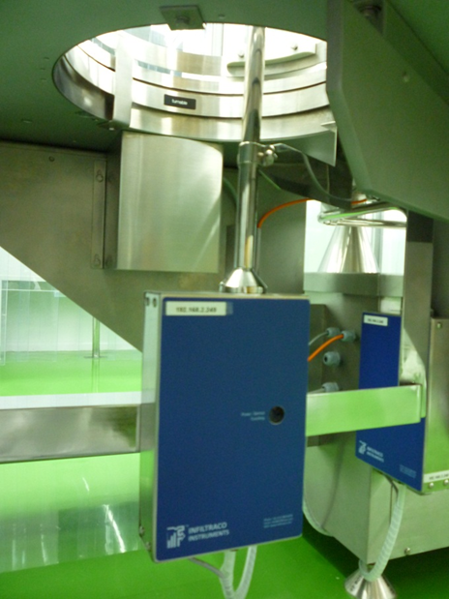
Grade A
Probe Position –Descrambler

Slide 21
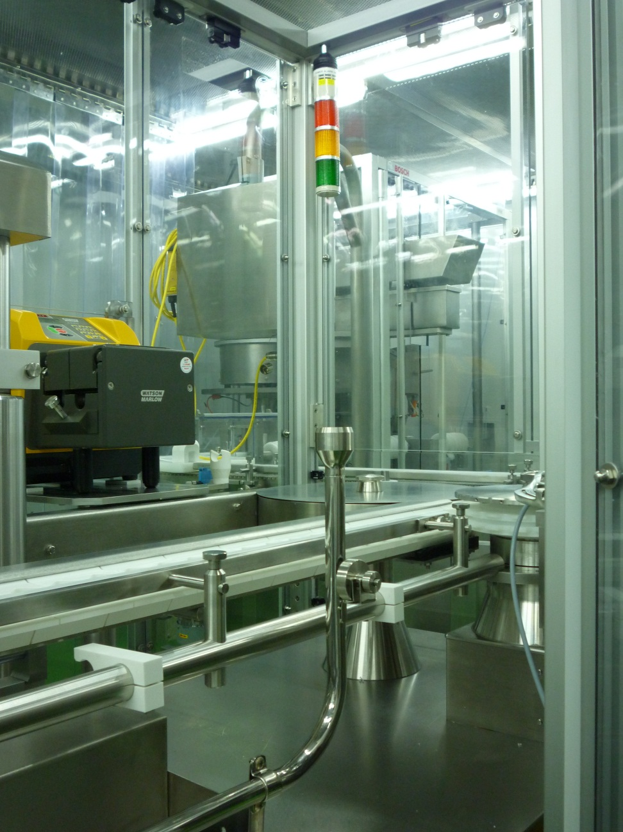
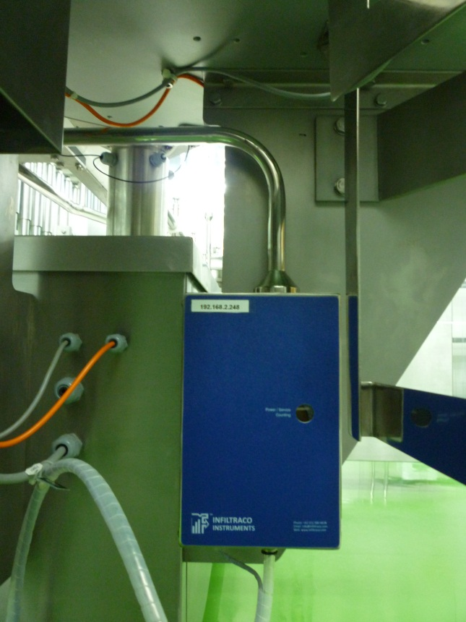
Grade A
Probe Position –Point of Fill

Slide 22
Grade A Design Considerations
Vial
Sterilising
Tunnel
Key
Remote
Counter
Vacuum
Tubing,
Power
& Data
Central
Software
System
Central
Vacuum
Pump
© TSI Incorporated
6/7/2019

Slide 23
Grade A Design Considerations
Ensure easy access to particle counter for routine maintenance and calibration
Locate the particle counter outside the critical areas if possible
Consider purchasing spare particle counters
Design the system so that you can “hot swap” remote particle counters in the event of sensor contamination
Decide on a single pump per particle counter or a single large vacuum pump for all counters with a vacuum manifold
For large vacuum pump systems always specify a master/slave configuration
Ensure vacuum pump exhaust air is either filtered or vented to atmosphere according to local regulations
© TSI Incorporated
6/7/2019

Slide 24
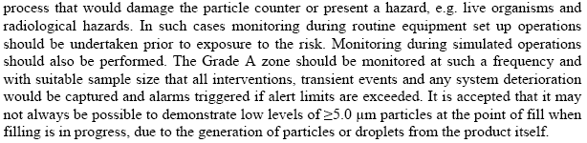
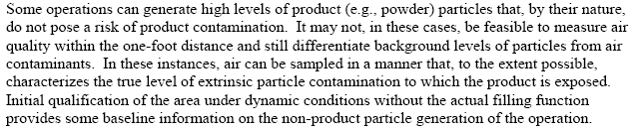
Interference from Product - Powder Filling
EU GMP Annex 1
US FDA Aseptic processing Guidance
© TSI Incorporated
6/7/2019

Slide 25
Interference from Product - Powder Filling
Unidirectional air bathing the exposed product during manufacturing
Higher sample probe for monitoring during production
Exposed product or vials/ampoules
Isokinetic sample probe for particle monitoring (not positioned directly over exposed product)
Less than
305 mm
© TSI Incorporated
6/7/2019

Slide 26
Interference from Product - Powder Filling
© TSI Incorporated
6/7/2019

Slide 27
ISOLATORS – Hydrogen Peroxide Vapour
Hydrogen Peroxide Gas may contaminate your particle sensor optics and particle transport tubing
Particle sensor are optical devices, VHP® resistance will not prevent particle sensor optics contamination
Sensor VHP® resistance will prevent particle sensor optics bleaching
Ensure non - return valves are installed in the vacuum line down stream of the particle counter to stop back flow in to negative pressure isolators and protect the isolator if there is loss of vacuum
© TSI Incorporated
6/7/2019

Slide 28
ISOLATORS – Hydrogen Peroxide Vapour
Ensure that the monitoring system can respond to the changes that take place when the isolator is in a gassing cycle or during leak testing, to dynamically implement alert and alarm limits preventing false alarms or meaningless data being collected
A valve will be required to protect the particle counter from contamination and facilitate the VHP®/HVP Sporicidal gassing process
© TSI Incorporated
6/7/2019

Slide 29
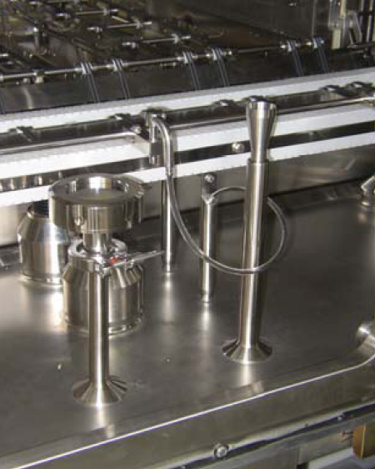

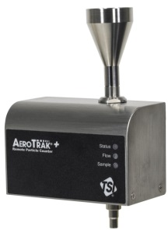
Isolators – installation examples
Viable sampling head (manifold vacuum design)
Particle sample probe
Particle counter Installed
under the Isolator
www.aseptd.com
© TSI Incorporated
6/7/2019

Slide 30
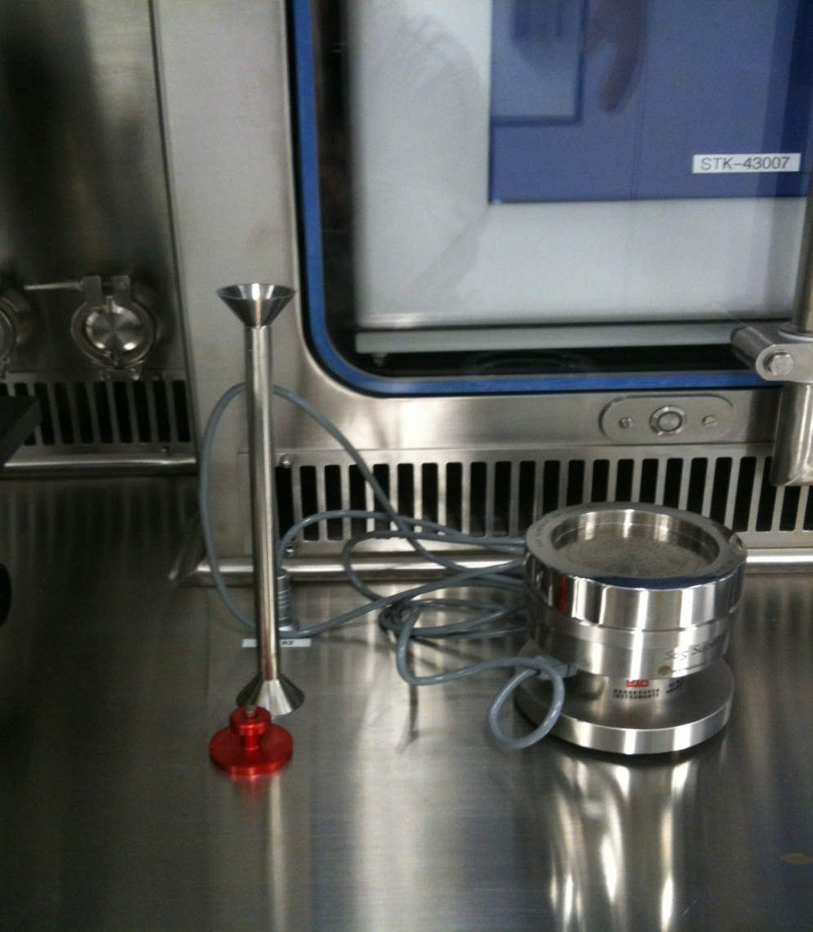
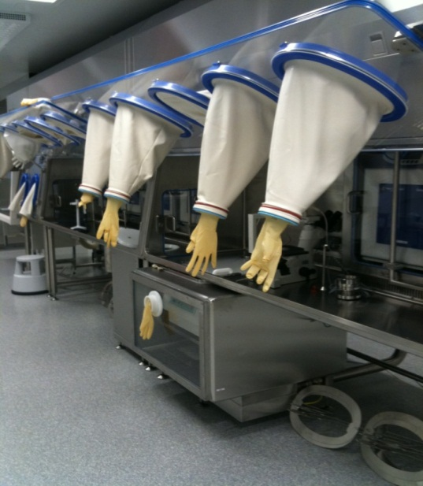

Isolators – installation examples
Particle isokinetic
sample probe
Viable sampling head (integrated vacuum design)
Note the viable sampling head can be moved
Particle sample probe cap
© TSI Incorporated
6/7/2019

Slide 31
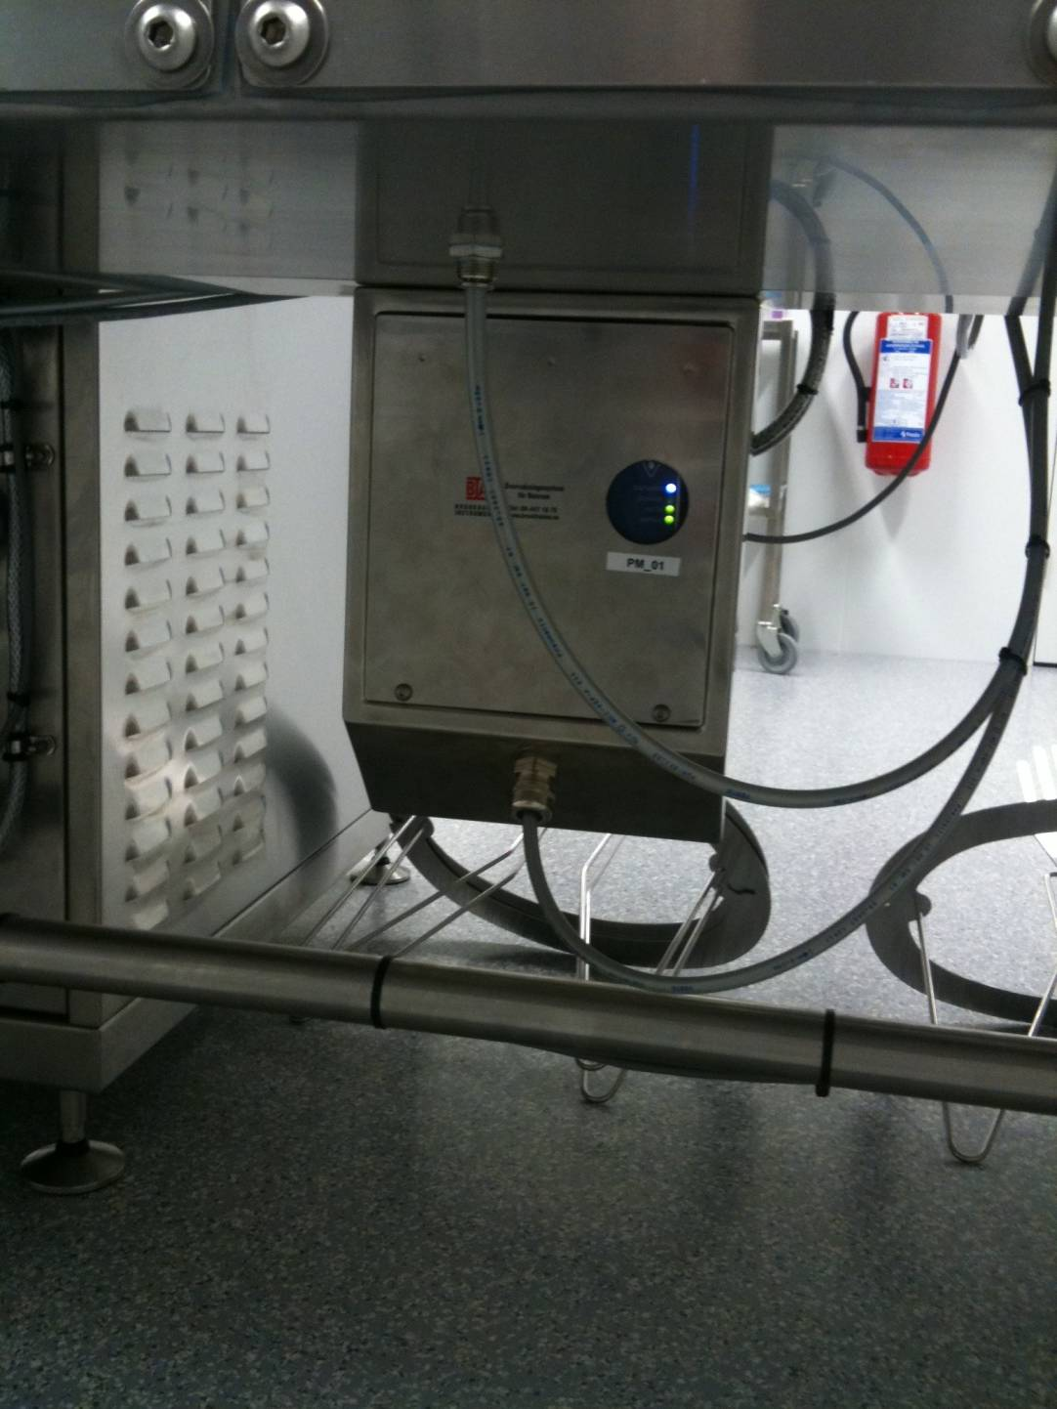
Isolators – installation examples
Particle counter installed under isolator in stainless steel enclosure
© TSI Incorporated
6/7/2019

Slide 32
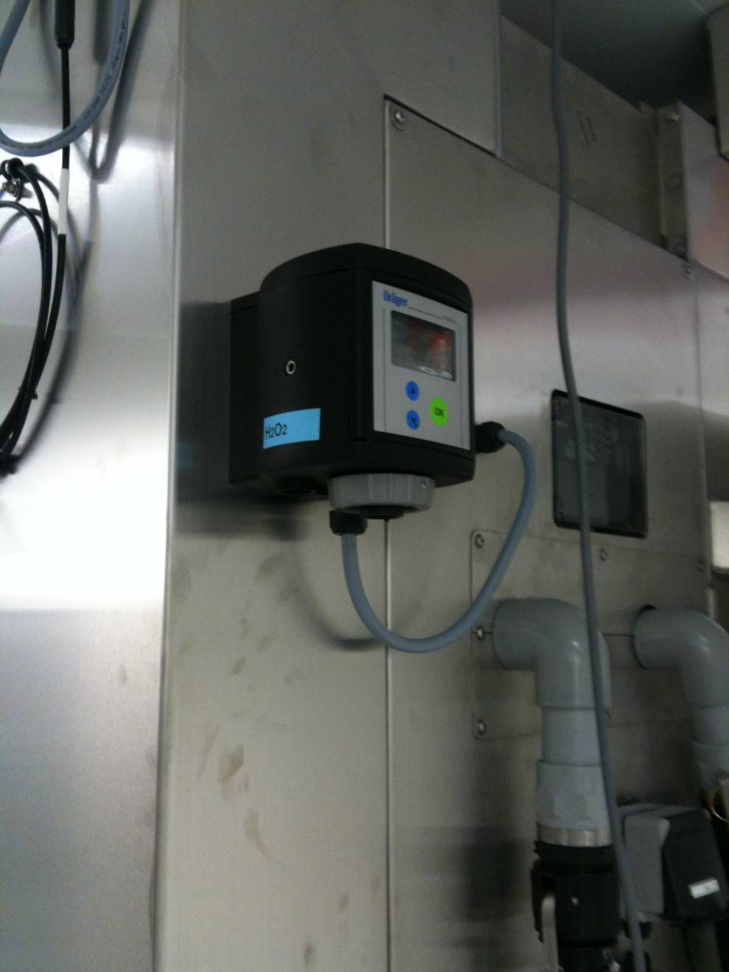
Isolators – installation examples
FMS is also monitoring vaporised hydrogen peroxide in the surrounding room
© TSI Incorporated
6/7/2019

Slide 33
GRADE B
Probe Positioning

Slide 34
Grade B - particle sample probe positioning
Identify critical areas based on a formal risk analysis study
Use particle cleanliness classification data to support your monitoring position selection
Use monitoring or qualification data from portable counters to support final monitoring position selection
Look at work flow activities to make sure it is possible to locate probe at this position
Combine this with smoke studies to support initial sample probe positions selection within these areas and the impact of the probe on airflows
Challenge the position by using smoke (contamination) and make sure the particle counter detects the excursion.
Document you rational and support with photographs
© TSI Incorporated
6/7/2019

Slide 35
Grade B – Identify Critical Locations
Risk Based approach to identifying Critical monitoring Locations – Note: these are not the final probe positions, in any case at this stage the facility may not yet be built!
Understand your process, regulator will not be prescriptive, they will say that you understand your process and are best qualified to make decisions
YOU will have to justify and document critical monitoring locations using sound scientific evidence to the regulator, saying XYZ person or company stated it was a good place to monitor is not enough
What does EU GMP Annex 1 and FDA cGMP say?
© TSI Incorporated
6/7/2019

Slide 36
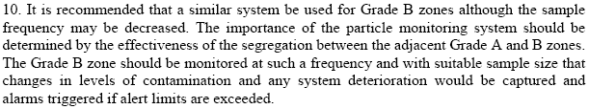
Grade B – Identify Critical Locations
EU GMP Annex 1
Remote particle counters are used to monitor Grade B zones when surrounding Grade A areas
© TSI Incorporated
6/7/2019

Slide 37
Grade B – Identify Critical Locations
Descrambler table
Vial
Sterilising
Tunnel
Filling
Zone
Stoppering
Zone
Capping
station
Where are the critical locations ?
What is the level of segregation between the Grade A and Grade B areas?
Where will there be operator interventions and therefore an increased risk of the Grade A and B zones coming into contact?
GRADE B
© TSI Incorporated
6/7/2019

Slide 38
Grade B
Identify Critical Locations:
Risk Based approach to identifying critical monitoring Locations – Note: these are not the final probe positions, in any case at this stage the facility may not yet be built!
Understand workflow in the Grade B Zone
What is the level of segregation between Grade A and B zones
  Open Process?
  RABS?
© TSI Incorporated
6/7/2019

Slide 39
Grade B probe positions
Vial
Sterilising
Tunnel
1
2
Capping
station
Descrambler
table
Filling
Zone
Stoppering
Zone
3
Grade B monitoring locations maybe as follows, following a risk analysis…….
Key
Grade B Probe location
Operator intervention
1
© TSI Incorporated
6/7/2019

Slide 40
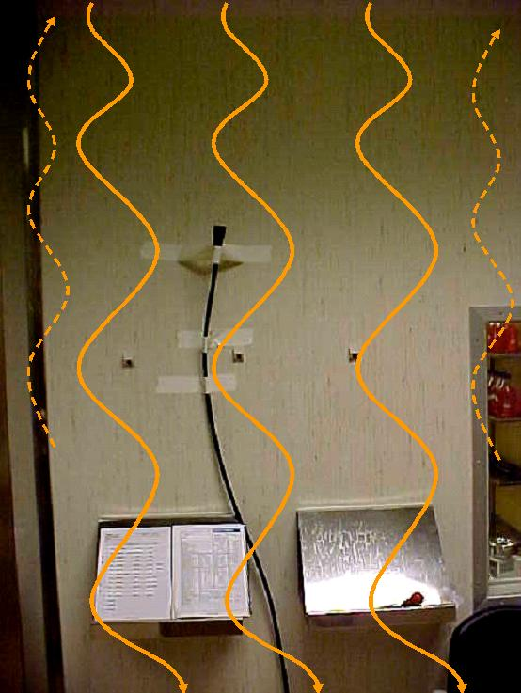
Grade B Probe Position Qualification
How do you determine the final probe location?
Use portable particle counter classification data
Use portable particle counters at the proposed sample locations when performing validation or qualification activities this will determine a probe location that is meaningful, ensure that this location does not interfere with the work flow
© TSI Incorporated
6/7/2019

Slide 41
Grade B Probe Position Qualification
How do you determine the final probe location? (continued)
Perform smoke visualisation studies to demonstrate that the proposed probe position is in an appropriate position
You can challenge the location by generating smoke to ensure the particle counter detects the excursion
Document with photographs
© TSI Incorporated
6/7/2019

Slide 42
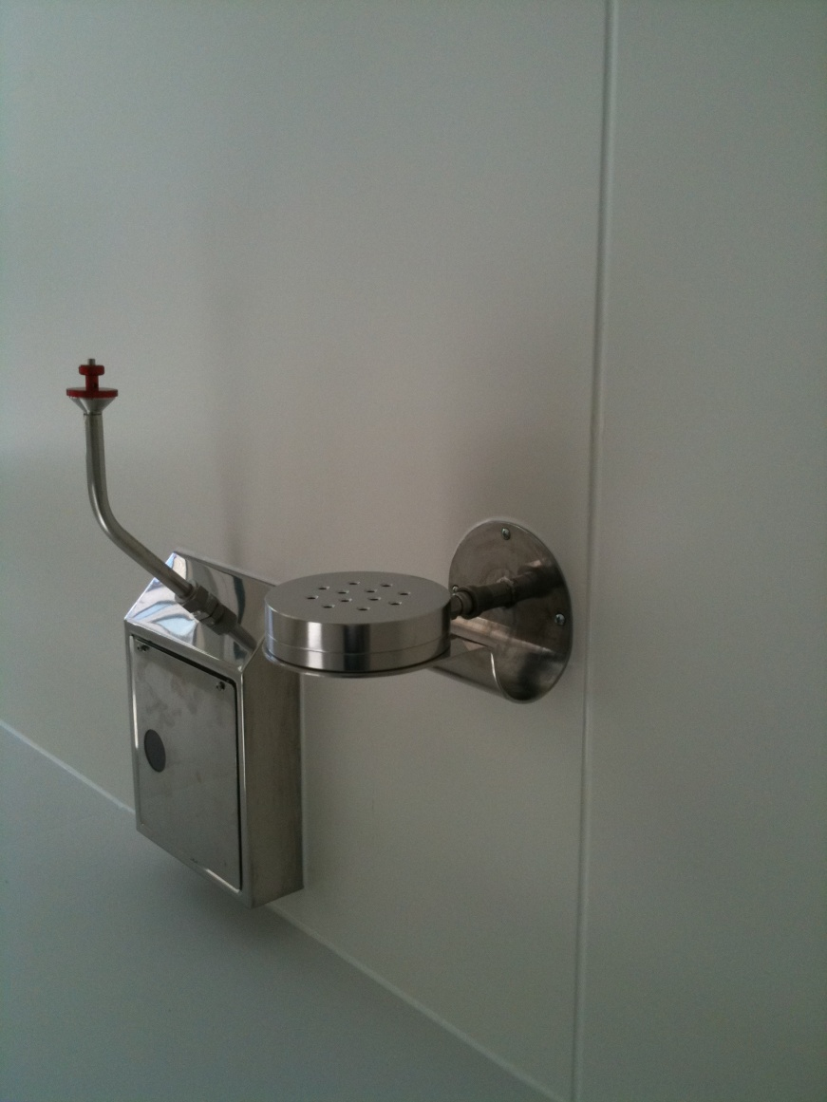
Grade B - Installation Example
Note smooth
bends in sample
tubing
Quick release probe cap
Particle
counter in
stainless steel enclosure
Viable sampling head
© TSI Incorporated
6/7/2019

Slide 43
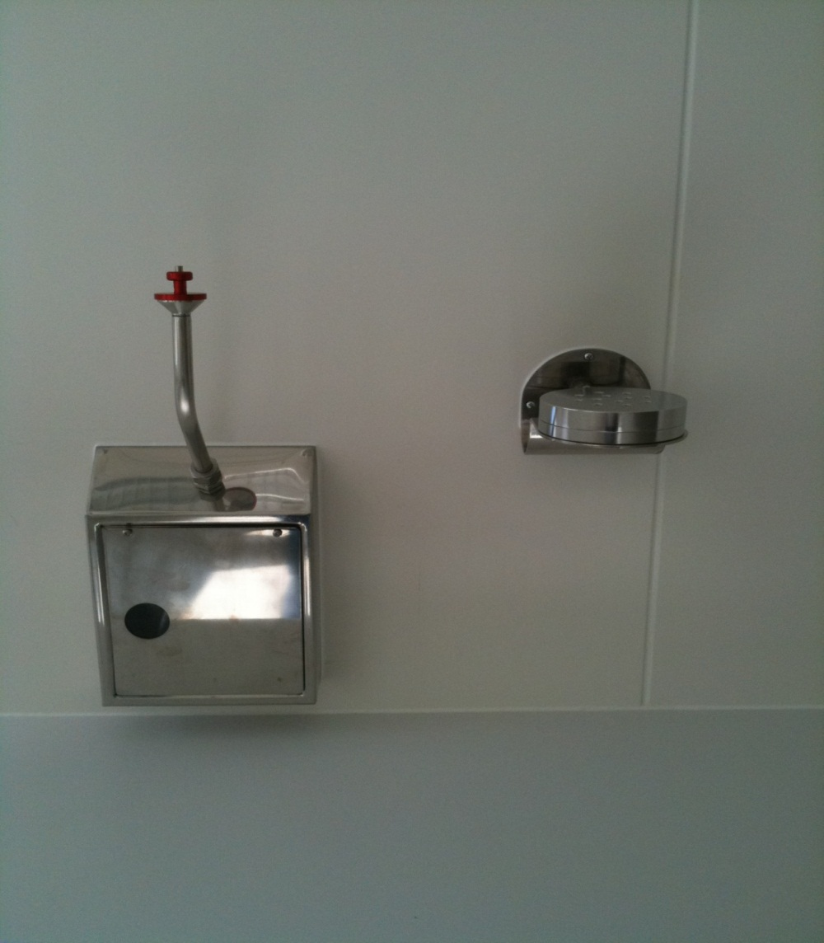
Grade B - Installation Example
Angled top, to allow cleaning solutions to run off
Quick release probe cap
Particle
counter in
stainless steel enclosure, note the view port
Viable sampling head
© TSI Incorporated
6/7/2019

Slide 44
Grade B Design Considerations
Distance from Remote counter to Isokinetic sample probe not more than 3 meters. Ideally sample tubing must be kept as short as possible
Sample tubing bends kept to a minimum (ideally no bends)
Bend Radii no less than 15cm
Particle sample tubing typically 3/8” Outside Diameter, ¼” Inside Diameter Bev-a-line tubing or stainless steel.
© TSI Incorporated
6/7/2019

Slide 45
Grade B – Design Considerations
Probe oriented in direction of airflow
For general room measurement probe is positioned 140 -170cm from the floor
Avoid placing probes close to doors
Avoid placing probes in corners
Ensure easy access to particle counter for routine maintenance
  Locate the particle counter outside the critical areas if possible
Consider purchasing spare particle counters
© TSI Incorporated
6/7/2019

Slide 46
Grade B – Design Considerations
Design the system so that you can “hot swap” remote particle counters
Decide whether you want a single pump per particle counter or a single large vacuum pump with a vacuum manifold distributing the vacuum to each counter, this is typically the same as Grade A vacuum design
For large vacuum pump systems always specify a master/slave configuration
Ensure vacuum pump exhaust air is either filtered or vented to atmosphere according to local regulations or guidelines
© TSI Incorporated
6/7/2019

Slide 47
GRADE C and D
Monitoring Locations

Slide 48
Grade C and D – Identify Critical Locations
Risk Based approach to identifying Critical monitoring Locations – Note: these are not the final probe positions, in any case at this stage the facility may not yet be built!
Understand your process, regulator will not be prescriptive, they will say that you understand your process and are best qualified to make decisions
YOU will have to justify and document critical monitoring locations using sound scientific evidence to the regulator, saying XYZ person or company stated it was a good place to monitor is not enough
What does EU GMP Annex 1 and FDA cGMP say?
© TSI Incorporated
6/7/2019

Slide 49

Grade C and D
EU GMP Annex 1
Any monitoring activities are determined using risk analysis
There is an expectation that these zones are monitored more frequently than the already specified qualification or classification intervals
Current thinking is that targeted Grade C monitoring may detect loss of control before the Grade C/B barrier is breached
© TSI Incorporated
6/7/2019

Slide 50
  QUESTIONS?
© TSI Incorporated
6/7/2019
50

