Slide 1
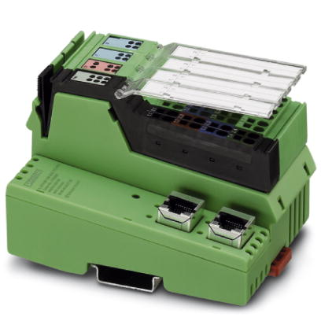
Phoenix Input/Output Controller

Slide 2
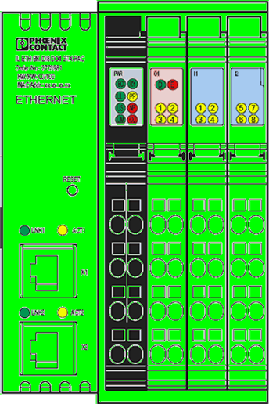
Bus Controller
IL ETH BK DI8 DO4 2TX-PAC – PN 2703981
Notes:
The controller comes with Ethernet communications, 4 digital outputs and 8 digital inputs. The outputs can be used for driving relays or low power alarm lights. The inputs could be used for door switches or vacuum pump monitoring, etc.

Slide 3
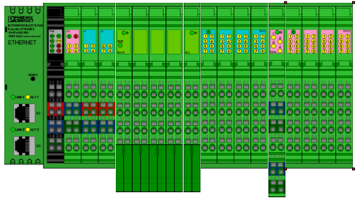
Overview- Environmental hardware field architecture
5/22/2019
3

Slide 5
Features
Provides power to individual modules
Integrated 4 digital outputs
Integrated 8 digital inputs
Stack 13 additional modules to expand the system
Mix digital and analog inputs and outputs with one controller
Ethernet communications to all sensors and outputs
Compact form factor

Slide 6
Features
2 or 3 wire sensor technology on the same module
4-20mA, 0-20mA, 0-10V, etc all on the same module
16 bit resolution
Short circuit proof for passive sensor supply voltage, however, use fused terminal blocks for field wiring.
Diagnostic indicator LED’s
Worldwide availability with technical support

Slide 7
Features
Color coded modules for ease of identification
Black = power
Pink = digital output
Blue = digital input
Green = analog input
DIN rail mount provide for grounding, both physical earth ground and functional earth ground
Eliminates parallel wiring of multiple modules

Slide 8
PHOENIX CONTACT
www.phoenixcontact.com

Slide 9
Specifications
General Data
Housing dimensions (width x height x depth) | 48.8 mm x 120 mm x 71.5 mm
Ambient temperature (operation) | -25°C to +55°C
Permissible humidity (operation) | 10% to 95%, according to DIN EN 61131-2
Connection data for Inline connector
Connection method | Spring-cage terminals
Conductor cross section | 0.2 mm² to 1.5 mm² (solid or stranded), 24 - 16 AWG
Transmission speed | 500kbps
Power consumption
Voltage | 24 VDC
Current | 52 mA

Slide 10
Controller Wiring
24VDC +
24VDC +
24VDC +
24VDC -
24VDC -
Notes:
The 24VDC power CAN be jumpered, but the preferred method is to power each terminal from a separate terminal block.

Slide 12
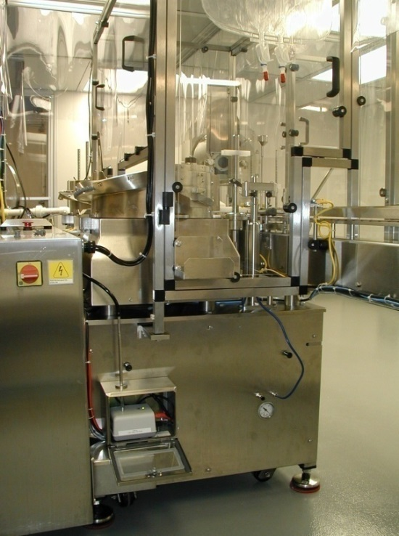
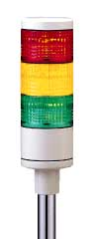
Digital Output Module 4 or 32DO
Additional Modules:
IB IL 24 DO 4-PAC – 2861276
IB IL 24 DO 32HD-PAC - 2862822
Notes:
It is possible to use digital outputs to control alarm lights or audio alarms or possibly to control power, through relays, to conveyors or other equipment.

Slide 13
Digital Output Specifications
General Data
Housing dimensions (width x height x depth) | 12.2 mm x 140 mm x 71.5 mm
Ambient temperature (operation) | -25°C to +55°C
Permissible humidity (operation) | 10% to 95%, according to DIN EN 61131-2
Number of outputs | 4
Output voltage | 24 VDC
Maximum output current per channel | 500 mA
Protective circuit | Overload protection, short-circuit protection of outputs Zener diode in output chip

Slide 14
Digital Output Wiring Slot 3-1,2,3,4
Slot 3-3
Slot 3-2
Slot 3-1
Slot 3-4

Slide 15
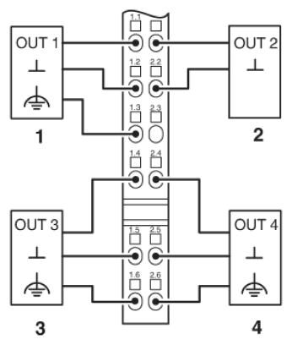

Slide 16
Digital Input Module
Additional Module:
IB IL 24 DI 32HD-PAC - 2862835
Input 1, Slot 2-1
Input 2, Slot 2-2
Input 6, Slot 2-6
Input 5, Slot 2-5
Input 8, Slot 2-8
Input 7, Slot 2-7
Input 4, Slot 2-4
Input 3, Slot 2-3

Slide 18
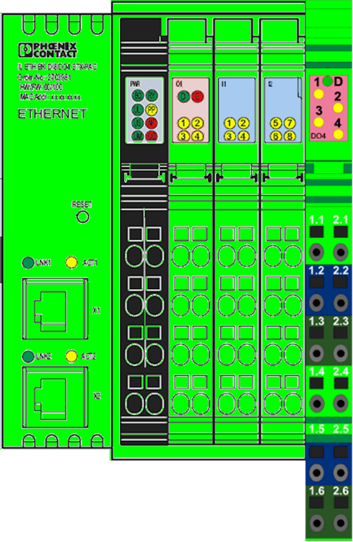
Analog Input Module
Additional Modules:
IB IL AI 2SF-PAC – 2861302
IB IL AI 8SF-PAC - 2861412

Slide 19
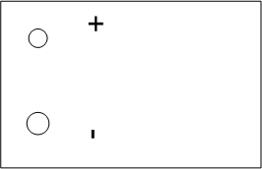
Analog Input Wiring Slot 4-2
24VDC
Power Supply

Slide 20
Analog Input Specifications
General Data
Housing dimensions (width x height x depth) | 12.2 mm x 120 mm x 71.5 mm
Ambient temperature (operation) | -25°C to +55°C
Permissible humidity (operation) | 10% to 95%, according to DIN EN 61131-2
Process data update of both channels | <1,5 ms
Behavior upon sensor failure | Goes to 0 mA/4 mA

Slide 21
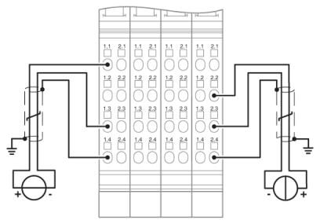

Slide 22
Slot Identification
Power Module-No slot number
Black Color
Digital Output—Alarms, etc
Pink Color
Slot 0-1
Slot 0-2
Slot 0-3
Slot 0-4

Slide 23
Slot Identification
Digital Input—Door Switches,
Lt Blue Color
Slot 1-1
Slot 1-2
Slot 1-3
Slot 1-4
Slot 1-5
Slot 1-6
Slot 1-7
Slot 1-8

Slide 24
Slot Identification
Digital Output—Alarms, etc
Pink Color
Slot 2-1
Slot 2-2
Slot 2-3
Slot 2-4
Digital Output—Alarms, etc
Pink Color
Slot 3-1
Slot 3-2
Slot 3-3
Slot 3-4

Slide 25
Slot Identification
Analog Input, T/RH, Δ P, etc
Green Color
2 Inputs, up to 8
Slot 4-1
Slot 542

Slide 26
Slot Identification
Analog Input, T/RH, Δ P, etc
Green Color
2 Inputs, up to 8
Slot 5-1
Slot 5-2
Can keep adding Modules up to 13
Analog Input, T/RH, Δ P, etc
Green Color
2 Inputs, up to 8
Slot 6-1
Slot 762

Slide 27
IP adress Assign Tool

Slide 29
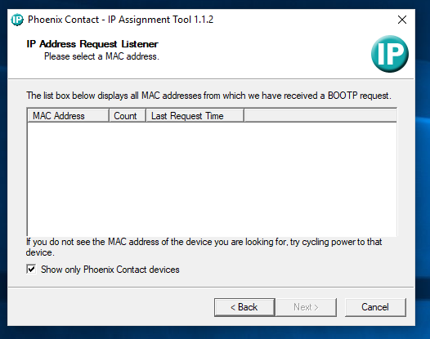

Slide 30
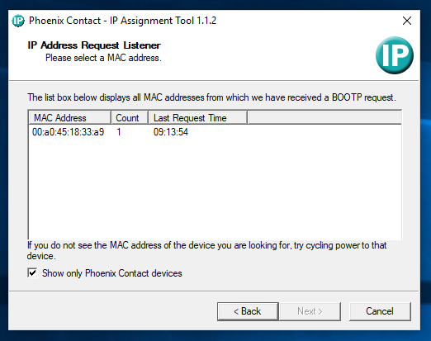

Slide 31
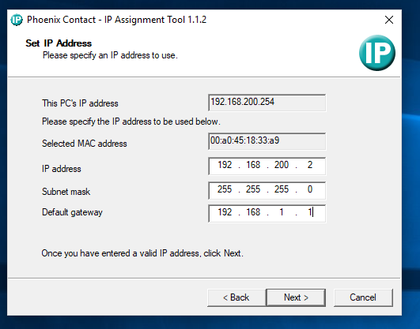

Slide 32
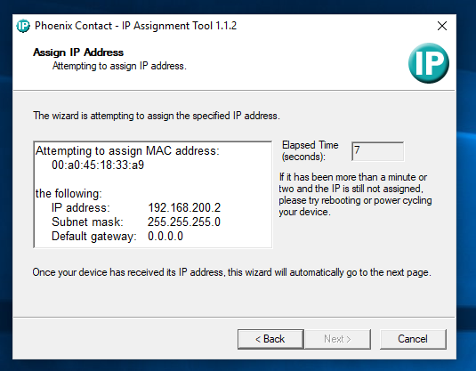

Slide 33
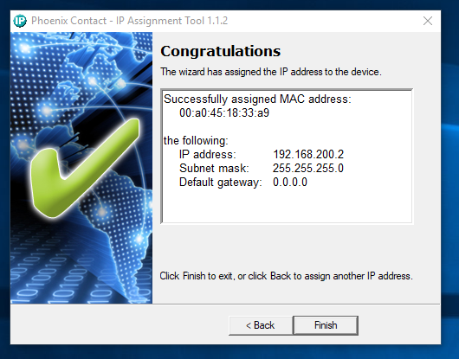

Slide 34
Integrated webpage

Slide 35
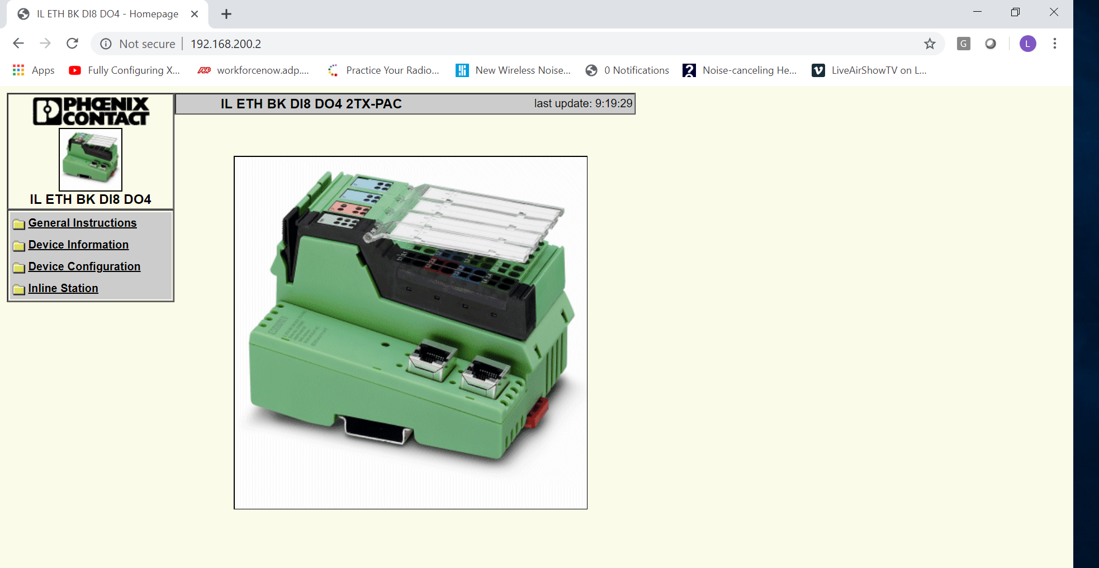

Slide 36
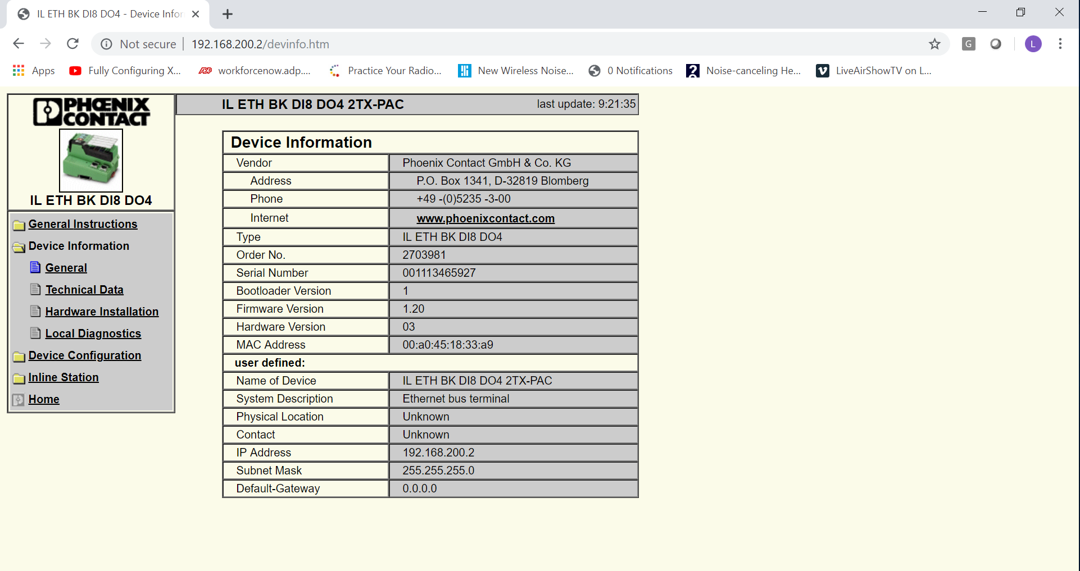

Slide 37
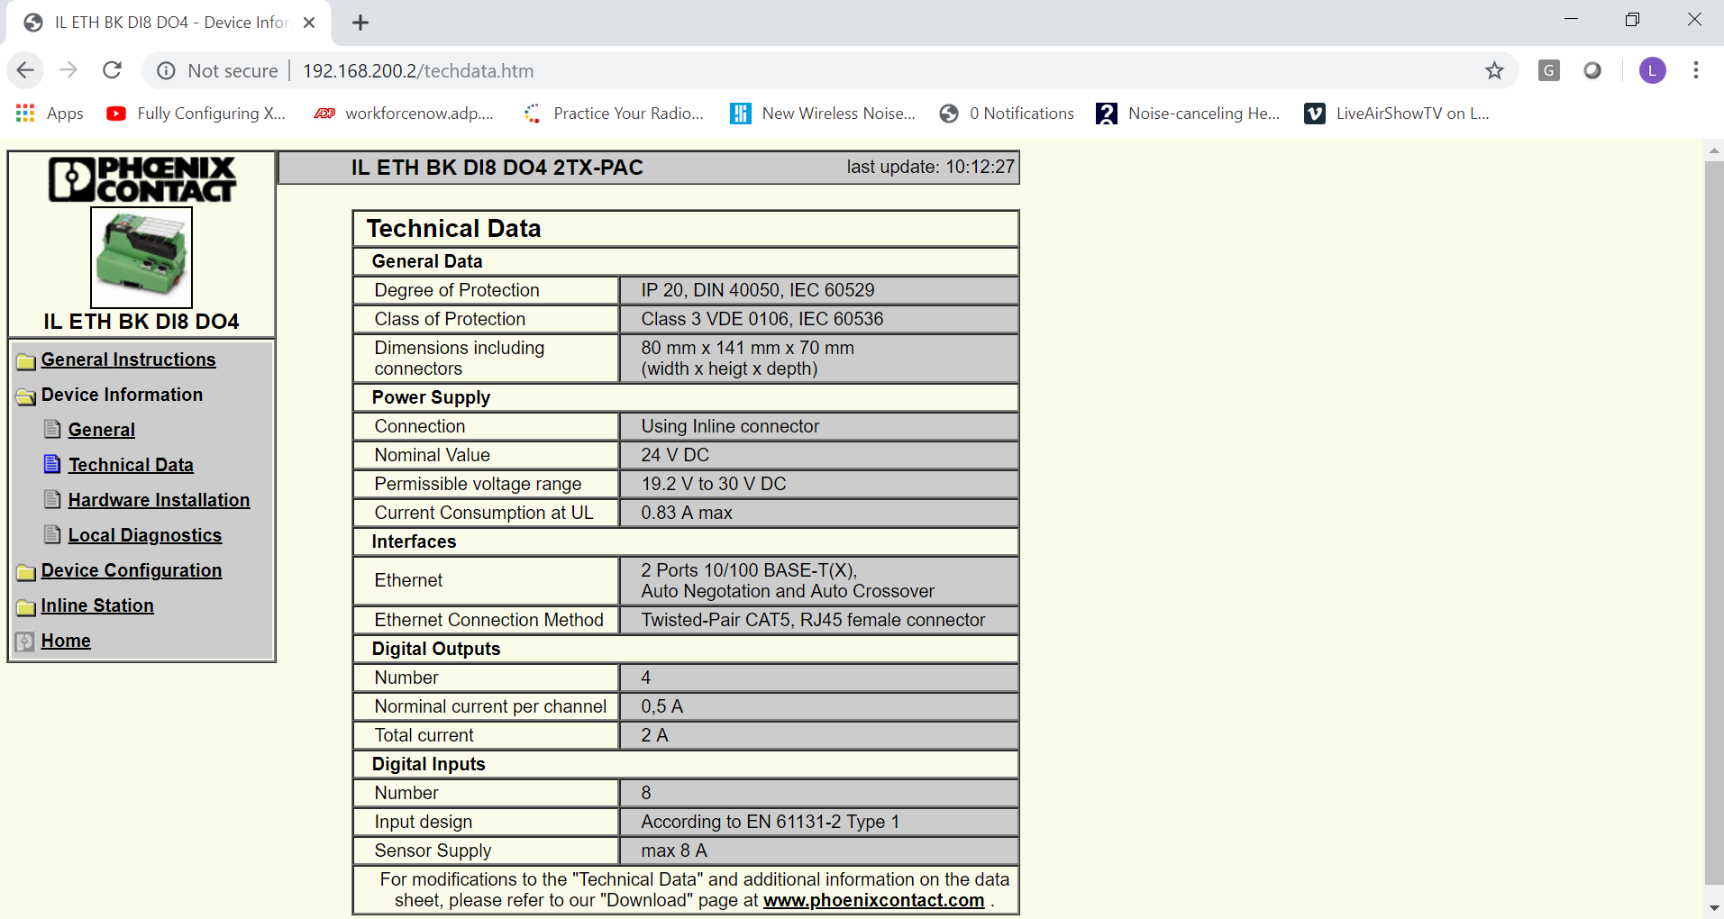

Slide 38
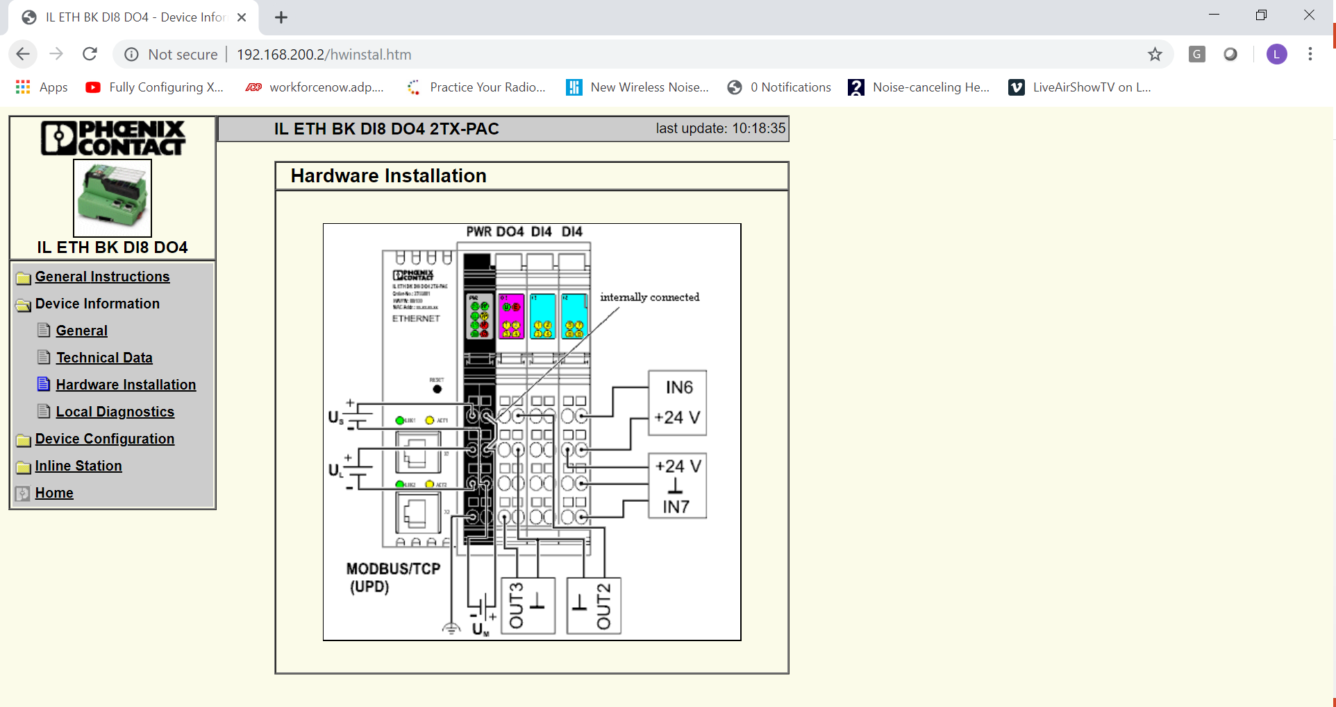

Slide 39
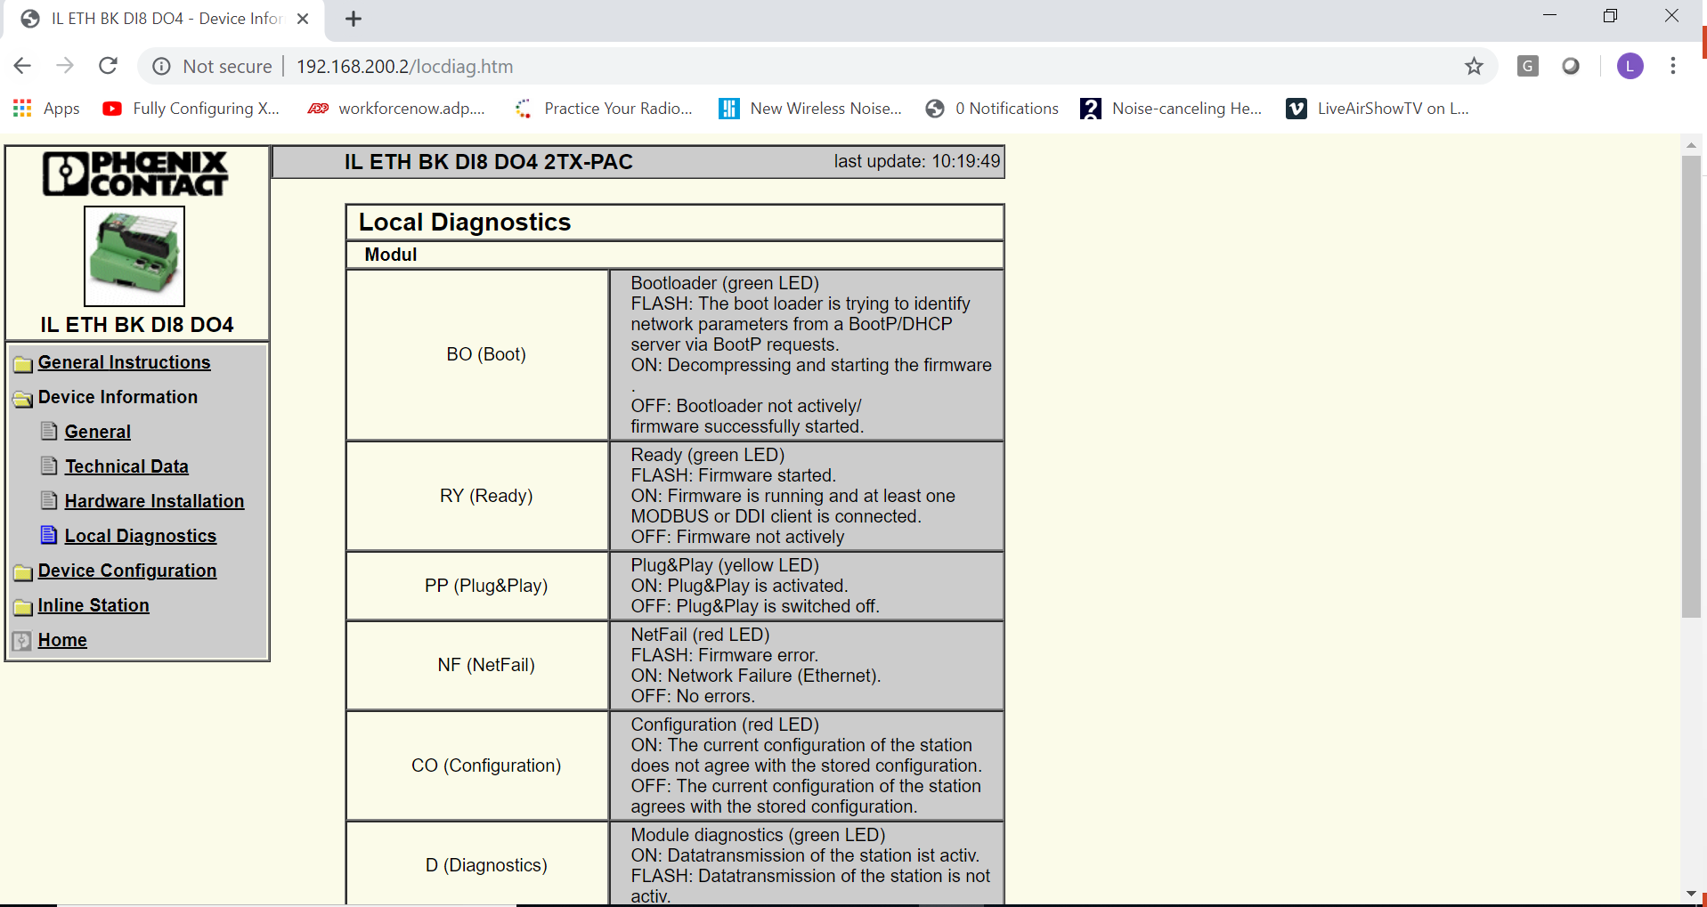

Slide 41
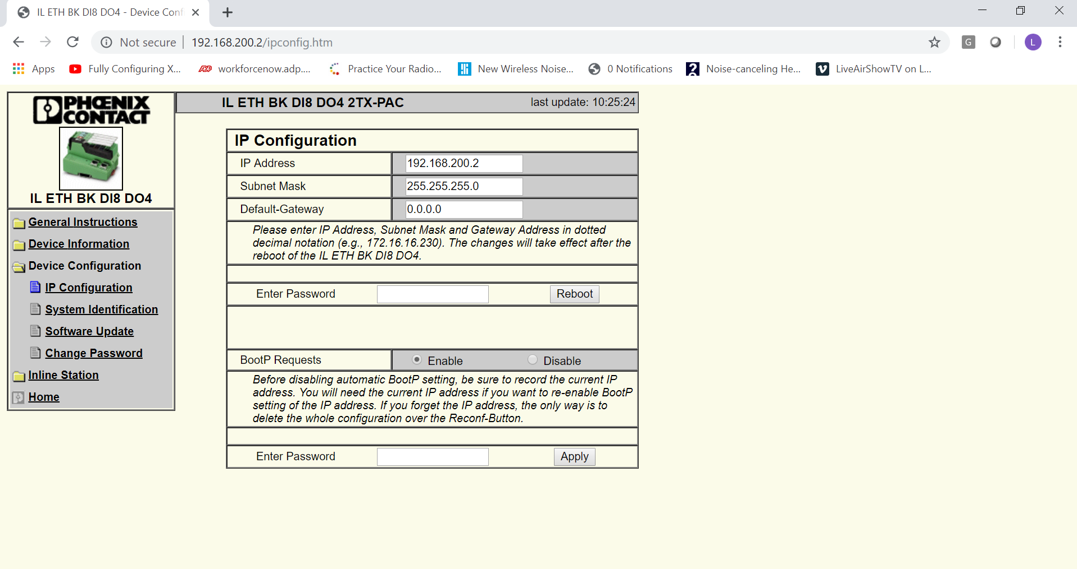

Slide 42
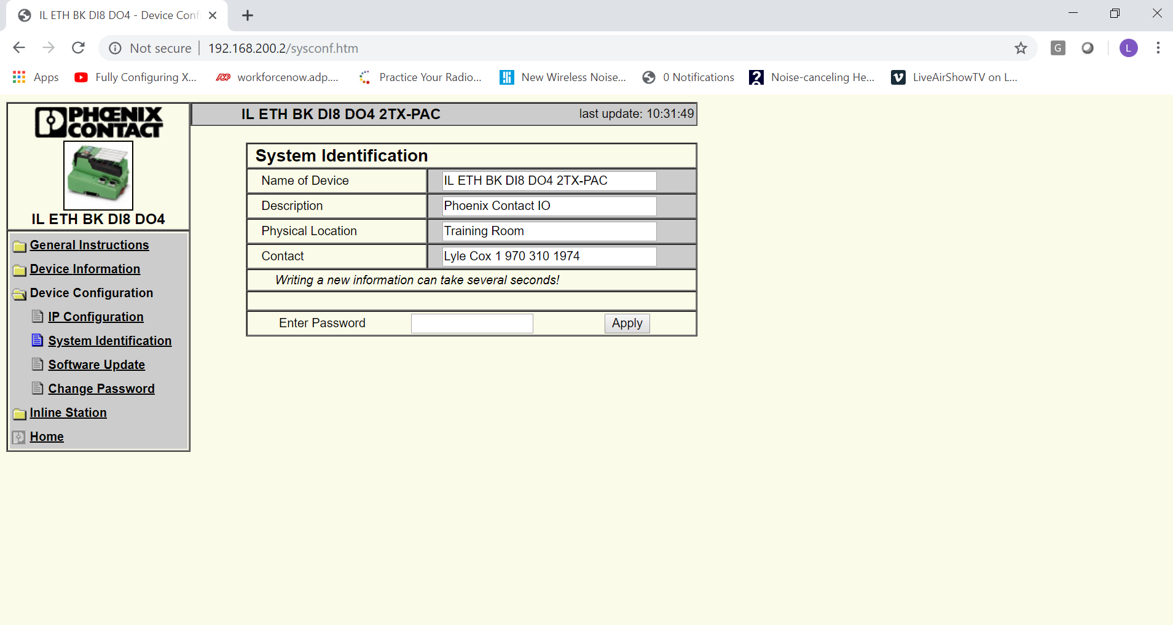

Slide 43
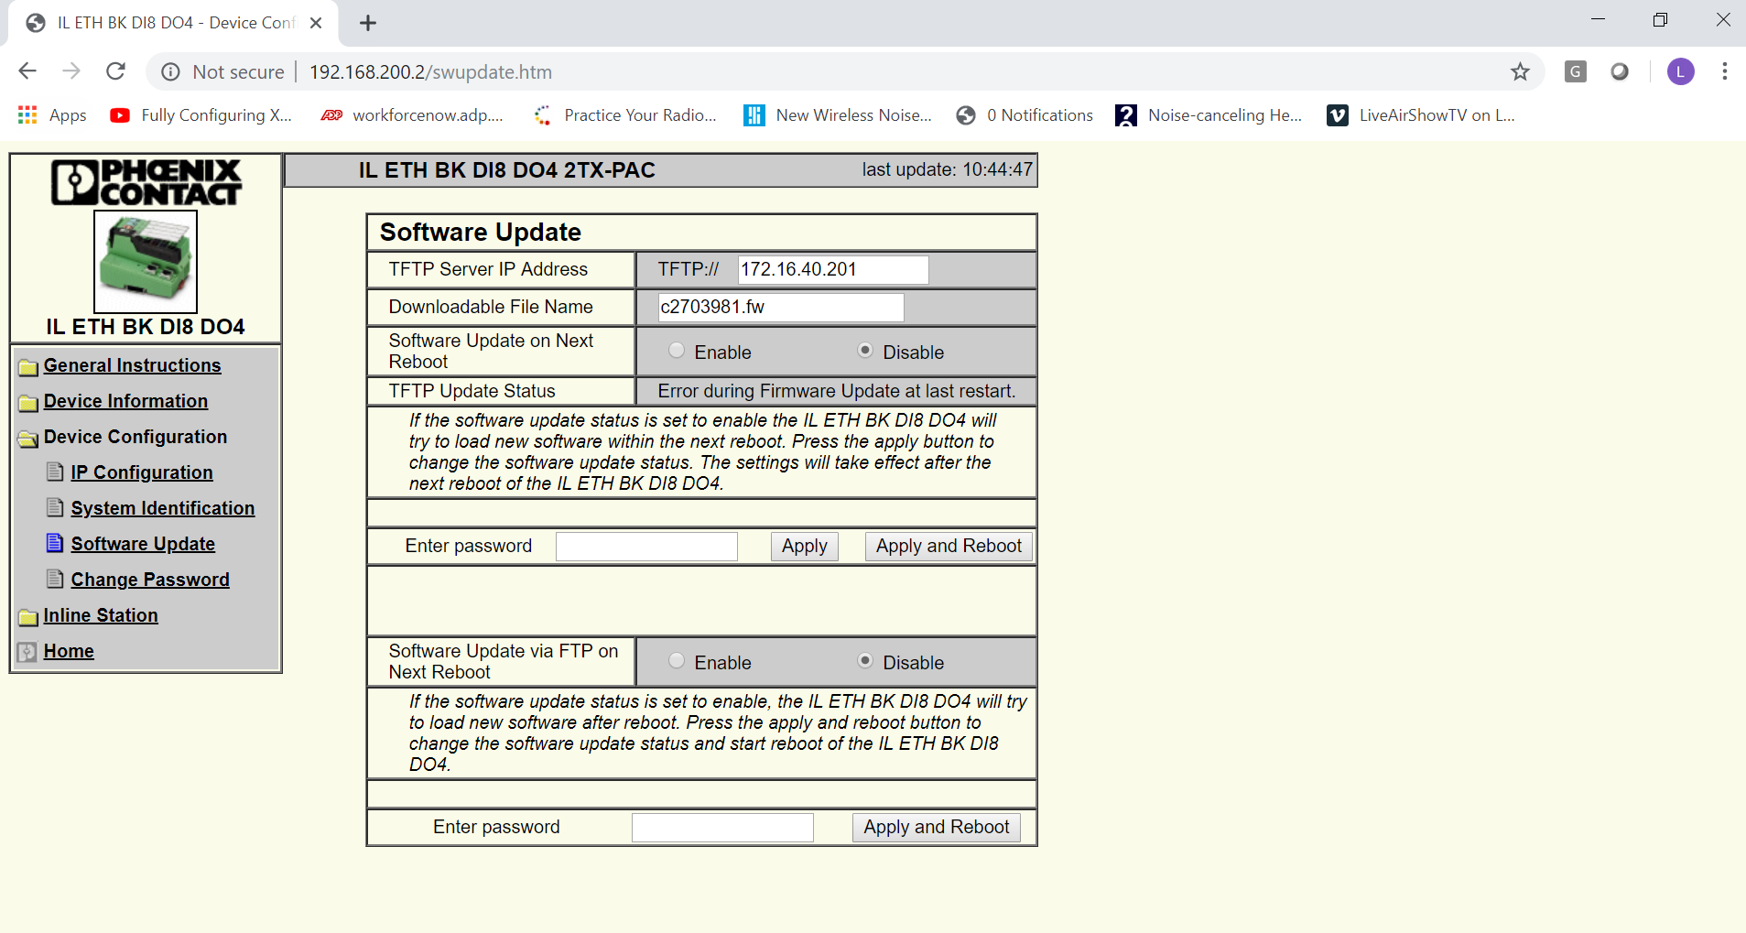

Slide 44
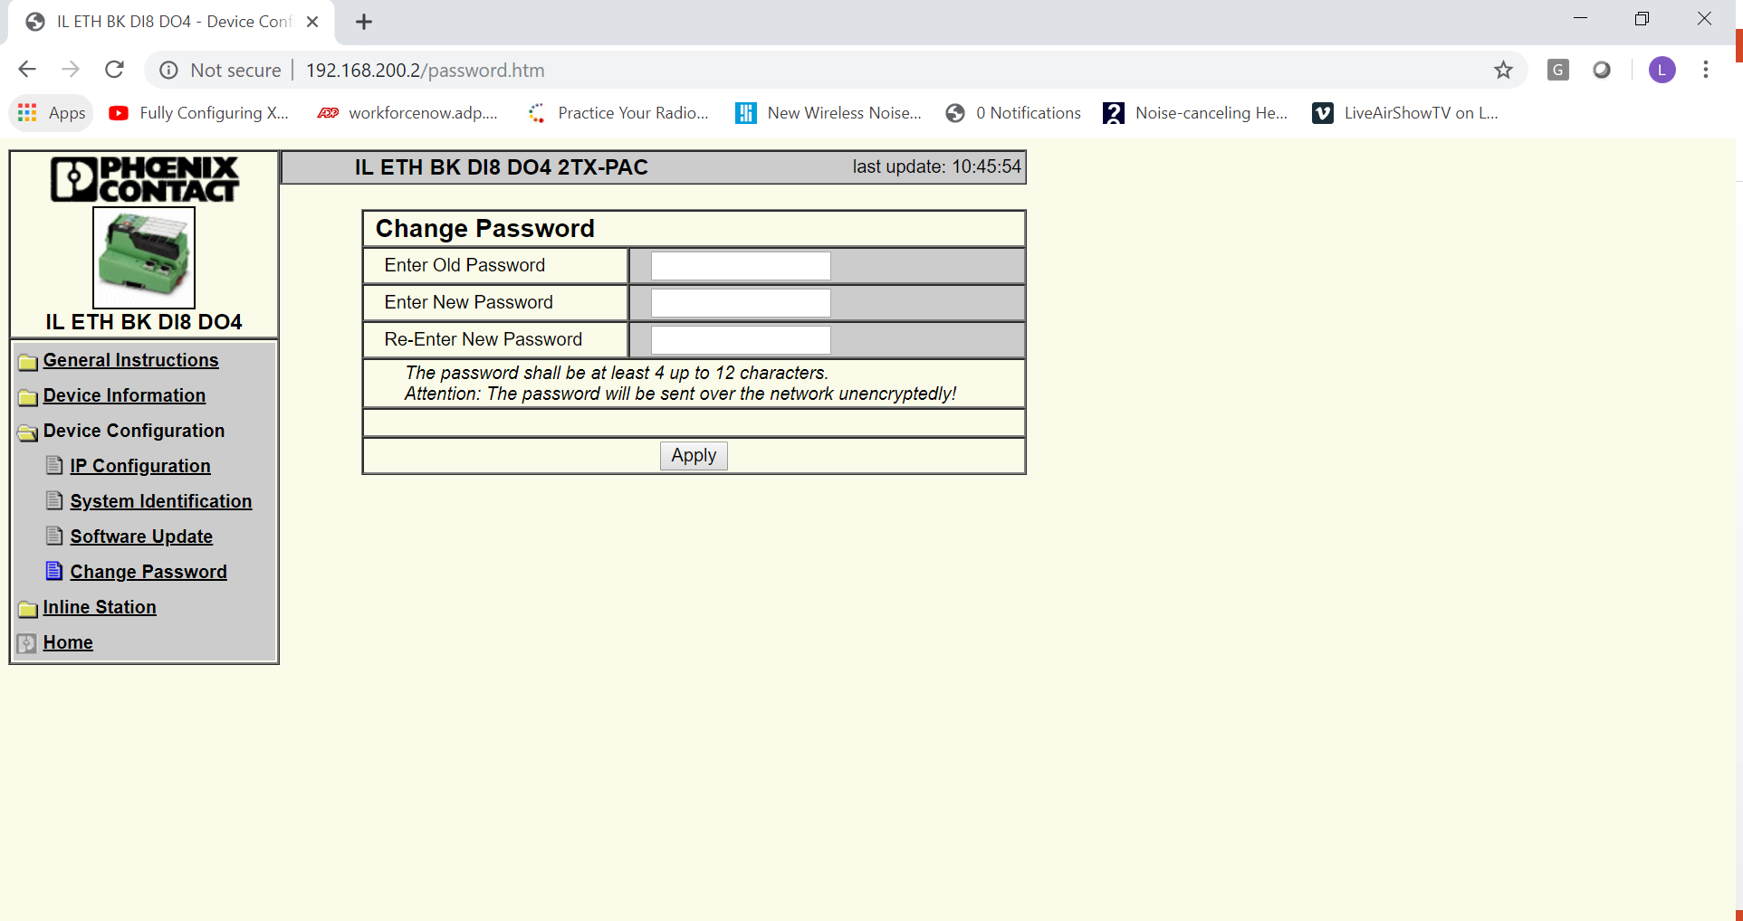

Slide 45
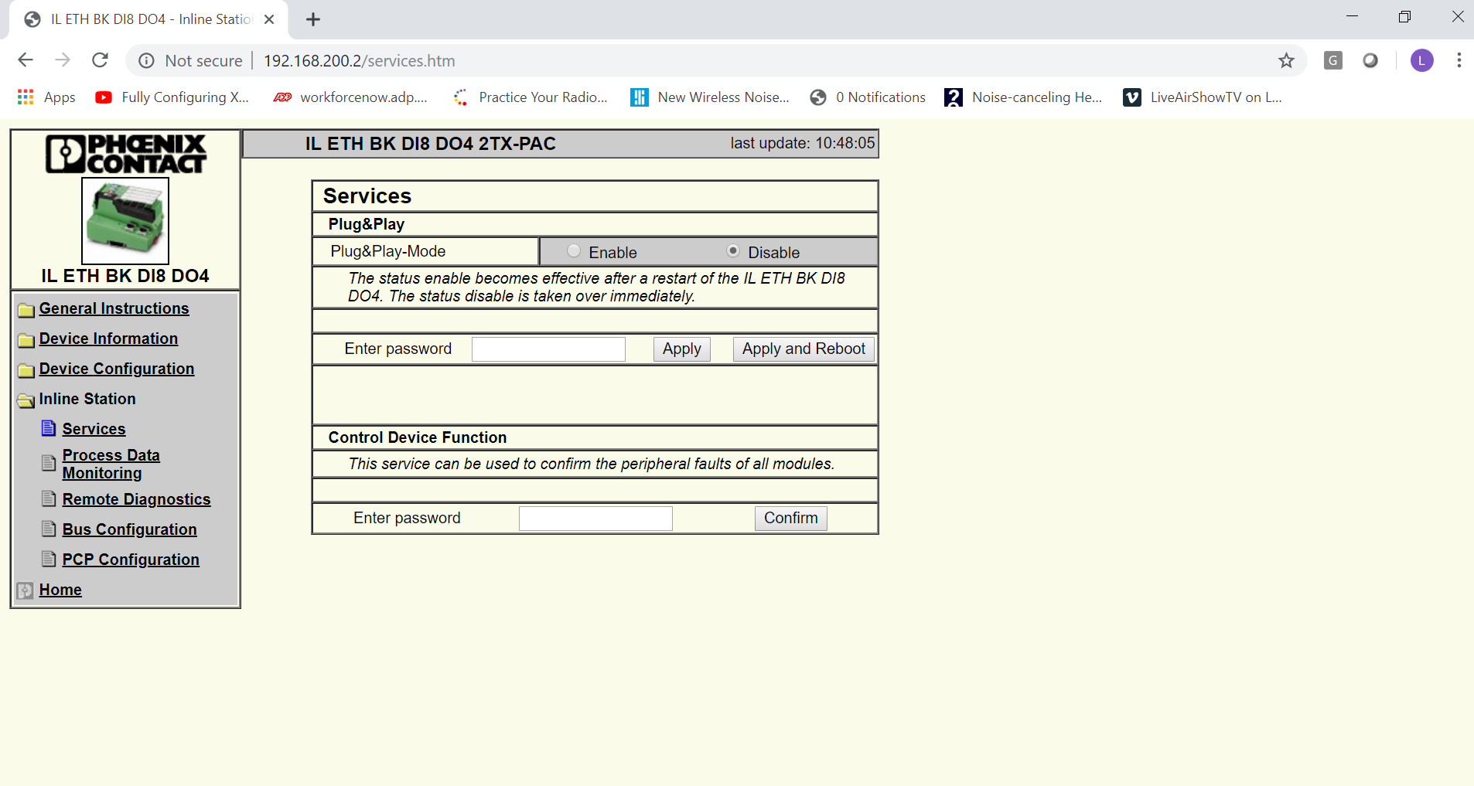

Slide 46
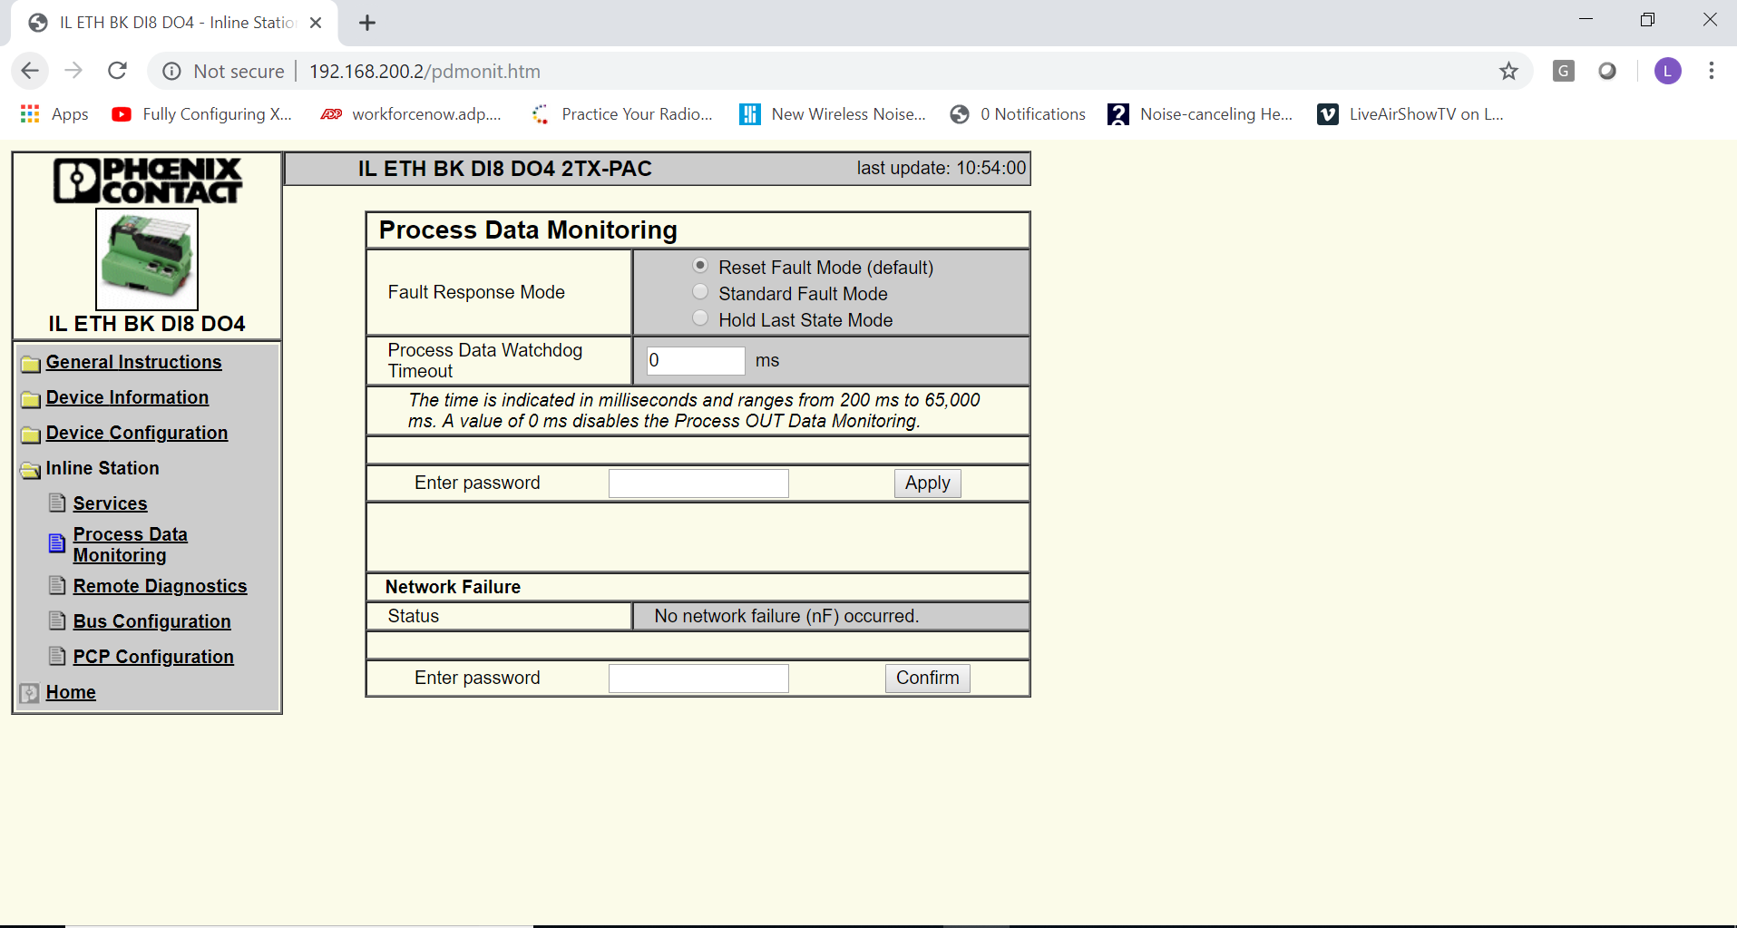

Slide 47
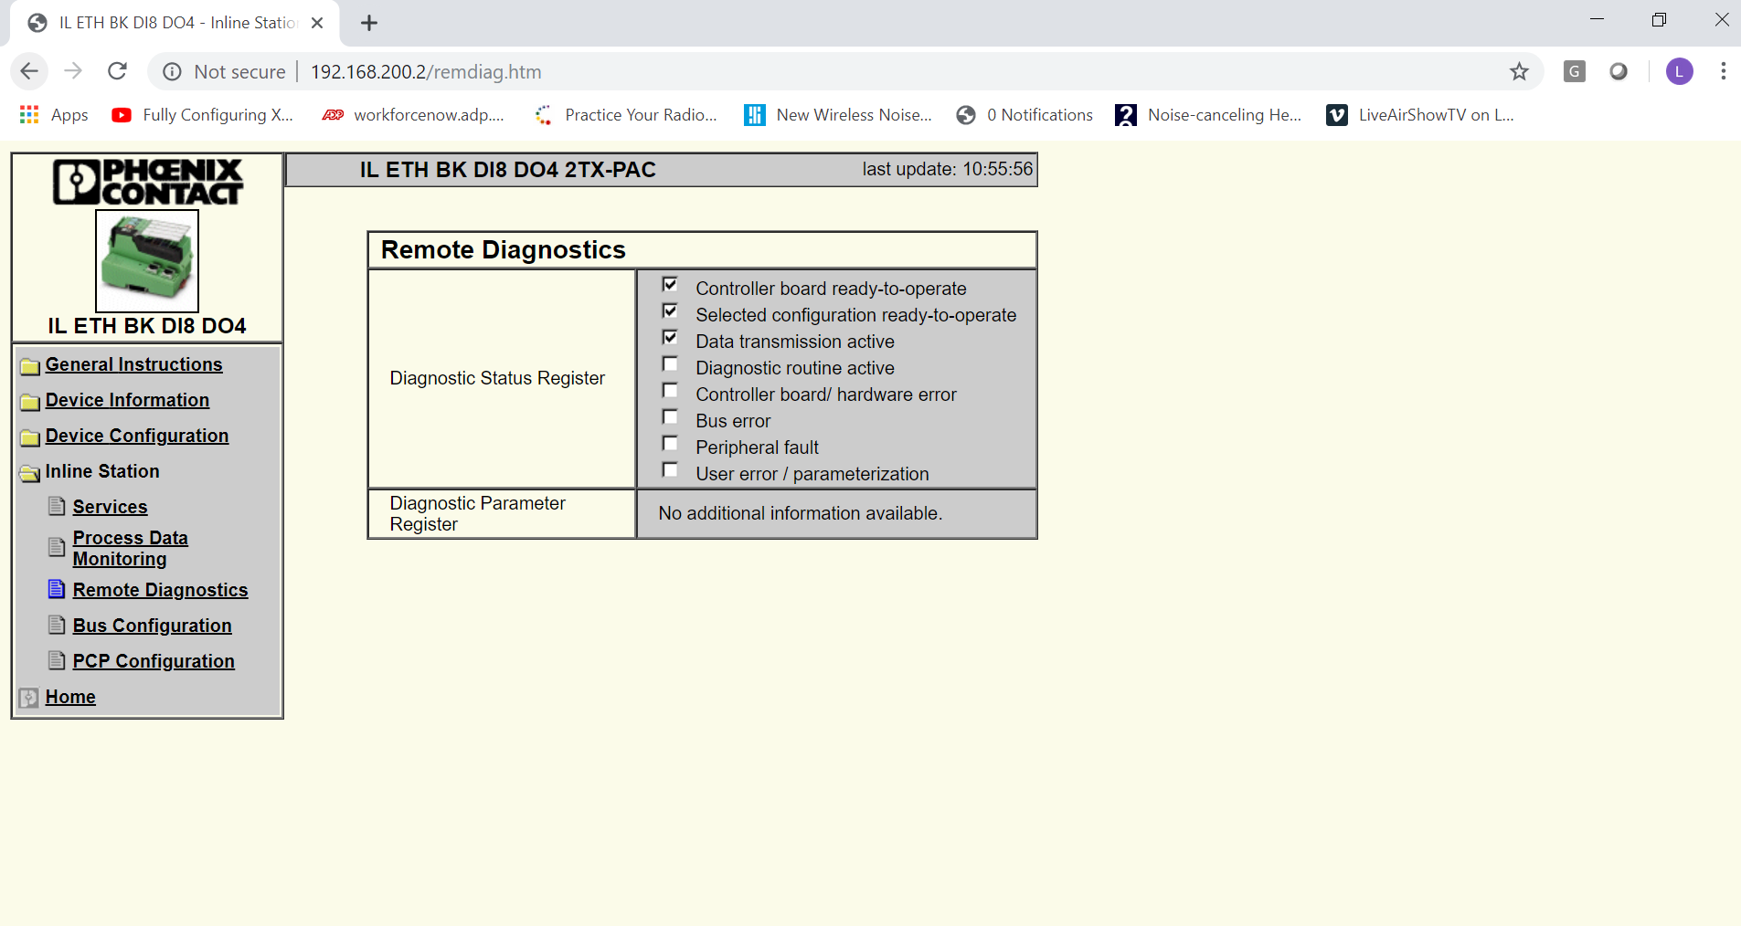

Slide 48
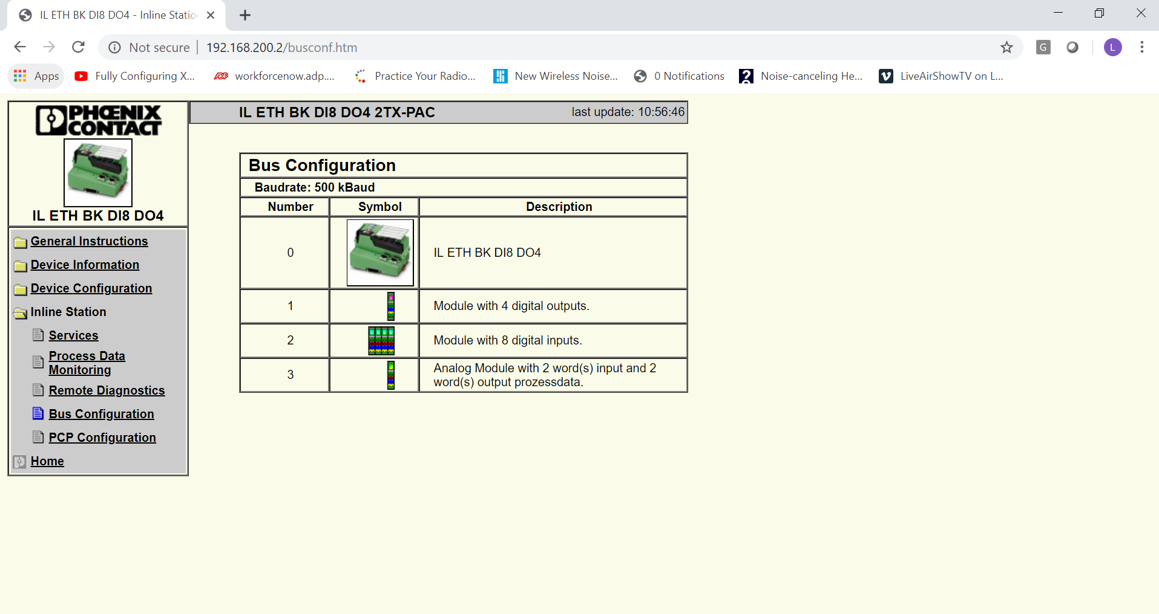

Slide 49
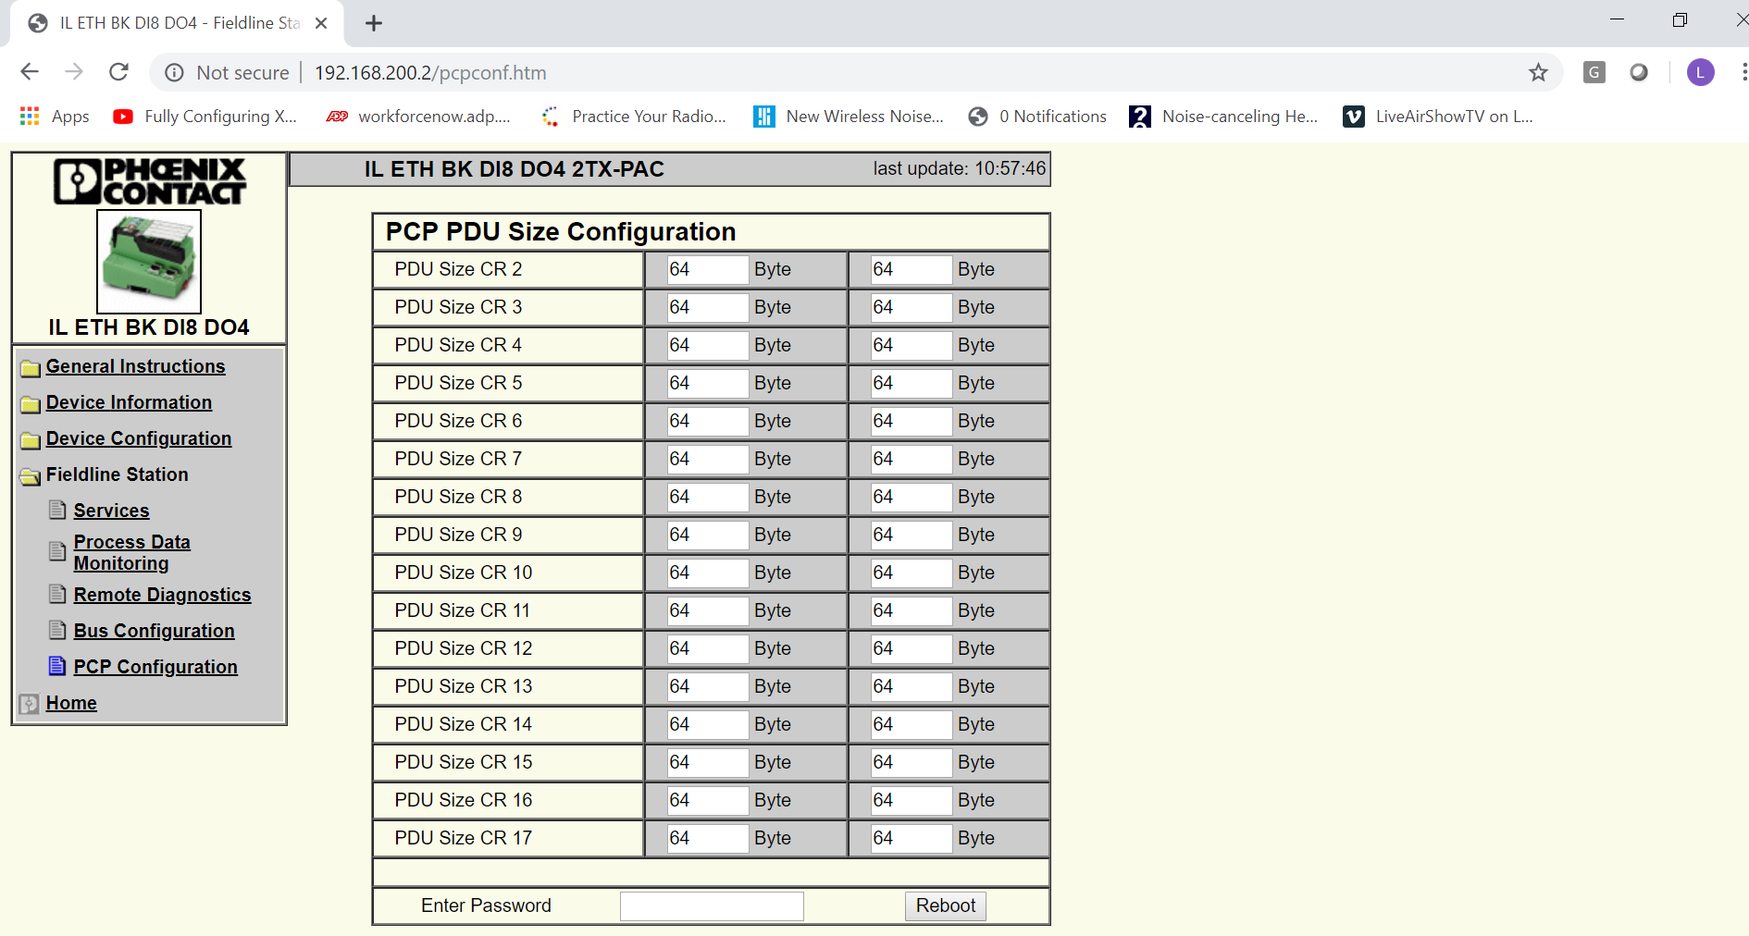

Slide 51
Questions??

